Slide 1

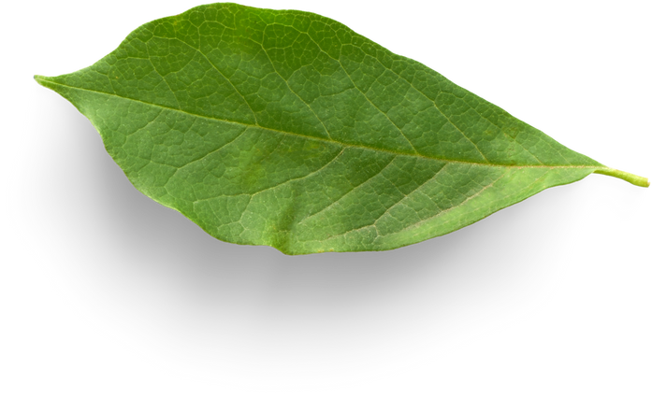
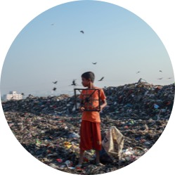


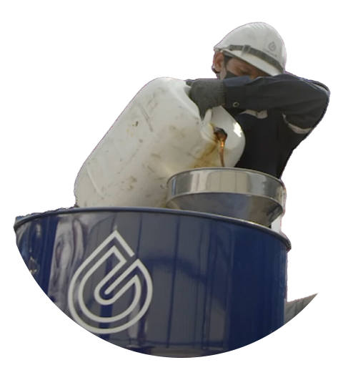
What we will see
In this presentation – or next time
PROBLEM
SOLUTION
VERIFICATION
OBJECTIVE
PLASTIC POLLUTION
CORSAIR GROUP
INTERNATIONAL
CSR PLASTIC CREDIT
CORSAIR/AMPLIVO
Notes:
What I’m going to cover, Problem, Solution, How we verify it and the immediate objective
Cast your mind back to before around 1960
We collected things from the shops in wicker baskets or paper bags, hardly anything was made of plastic as we know it
Carrier bags were made of cloth; bottles were glass and far more things than now were made of metal.
All these things were biodegradable or could be melted down and re-used – recycled
Plastic isn’t degradeable – it does break down into smaller and smaller pieces and this is what happens

Slide 2


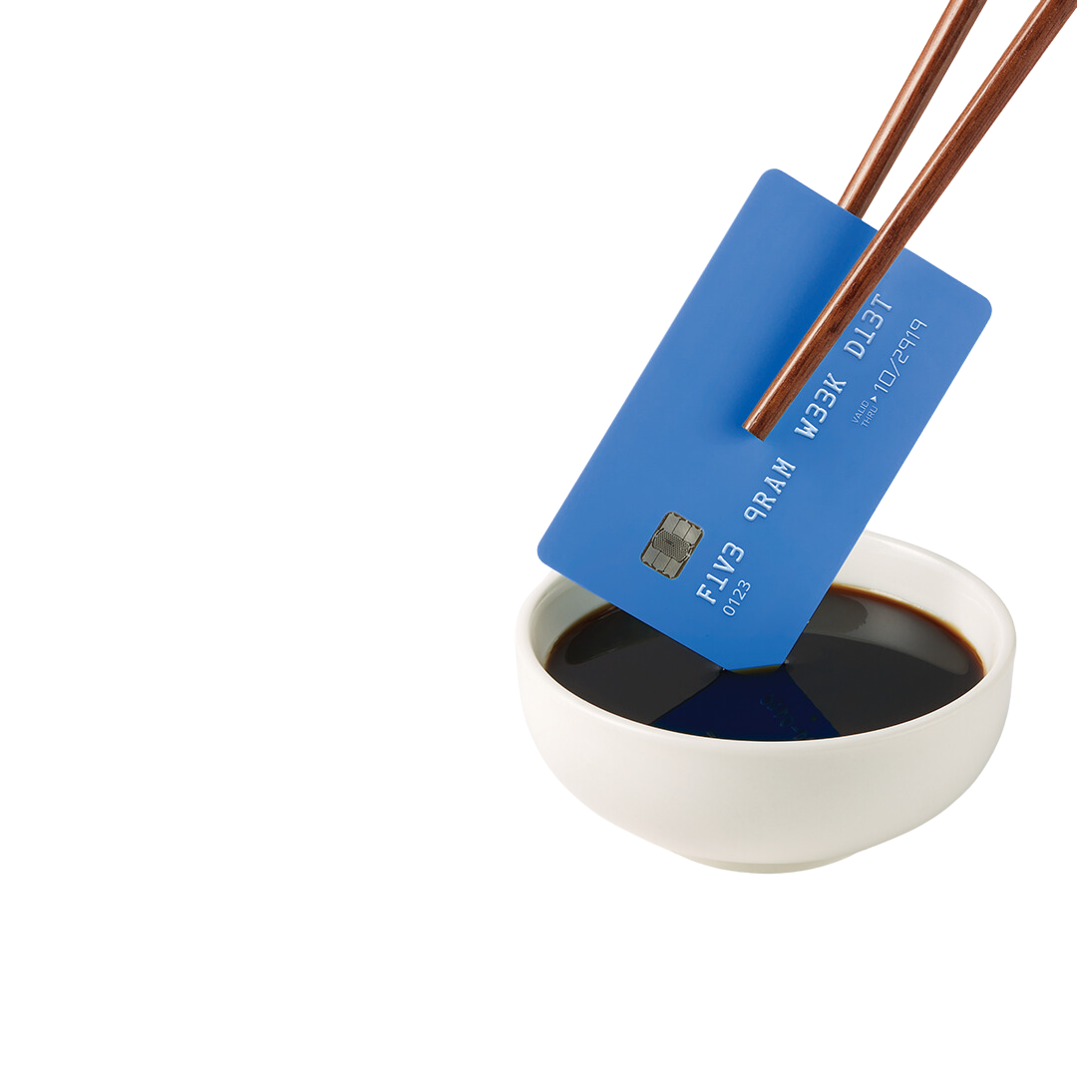
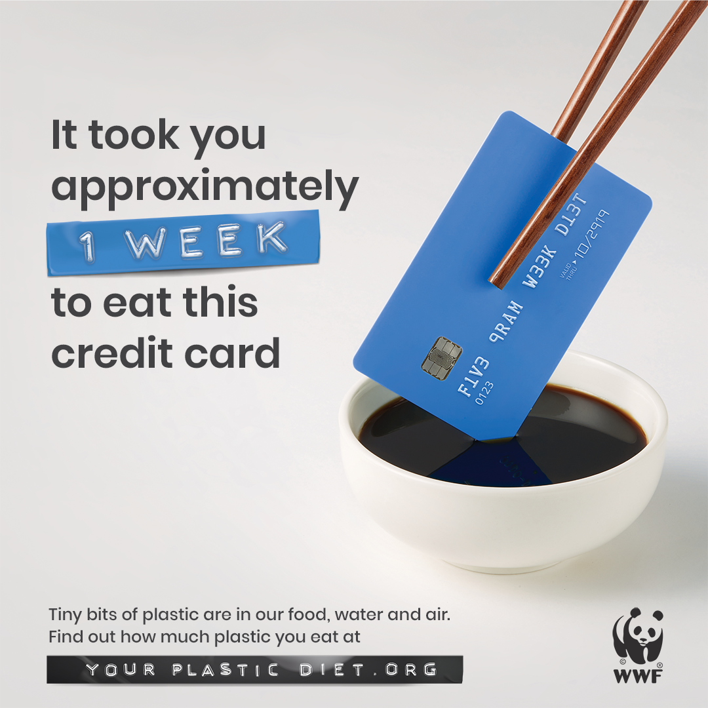



WWF study case
We ingest
5 GRAMS
of microplastics EVERY WEEK
yourplasticdiet.org
Notes:
Microplastics are in our food, our drink and the air we breathe
They don’t just ‘pass through’ the body they sit around, in our blood, our brain cells and other vital organs, clogging them up and causing a variety of malfunctions

Slide 3
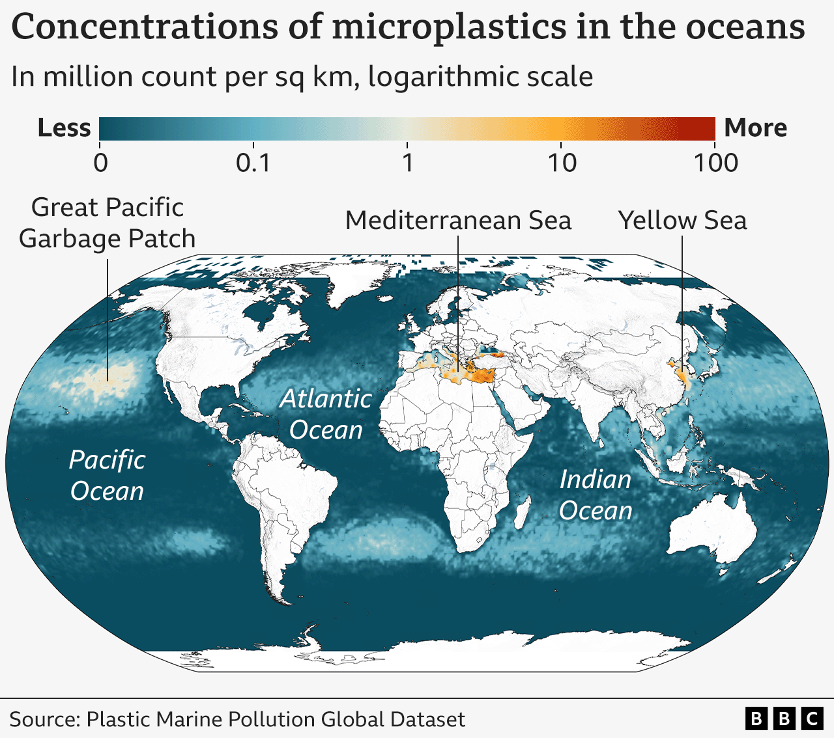
Notes:
When it hasn’t broken down in this way it floats around in the seas.
Ocean currents case waste plastic to aggregate in various places but where there aren’t many current as in the Mediterranean the plastic can’t get out.
It ends up on the beaches, in the coral and just generally causing a hazard to wildlife and what we do in the sea

Slide 4
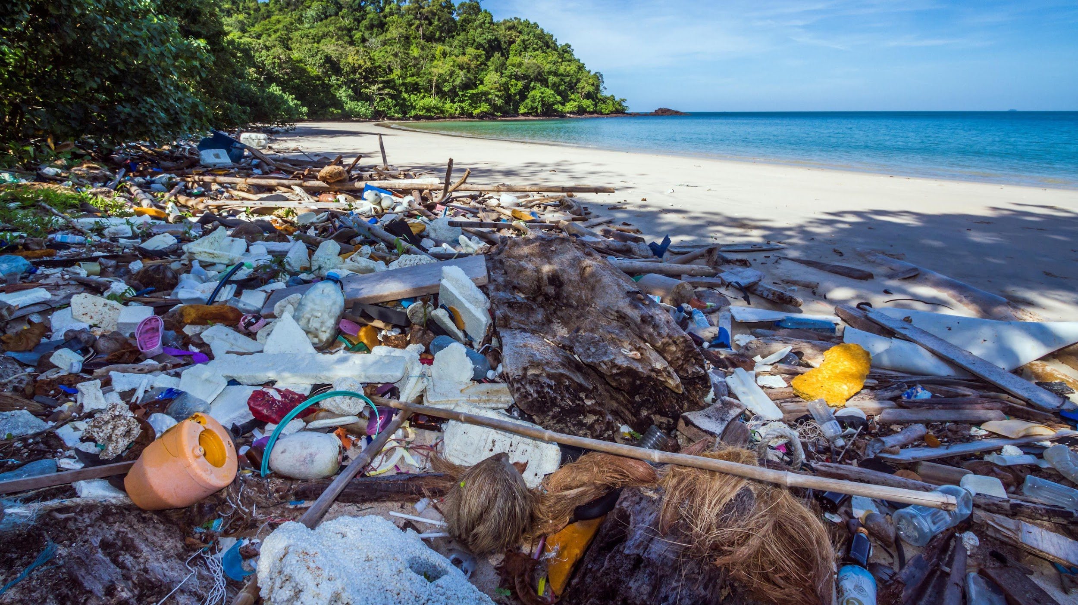
Notes:
Is this how we want it to look on our next holiday?
This is a beach off the tourist track in Thailand, there are also beaches like this in Cyprus

Slide 5
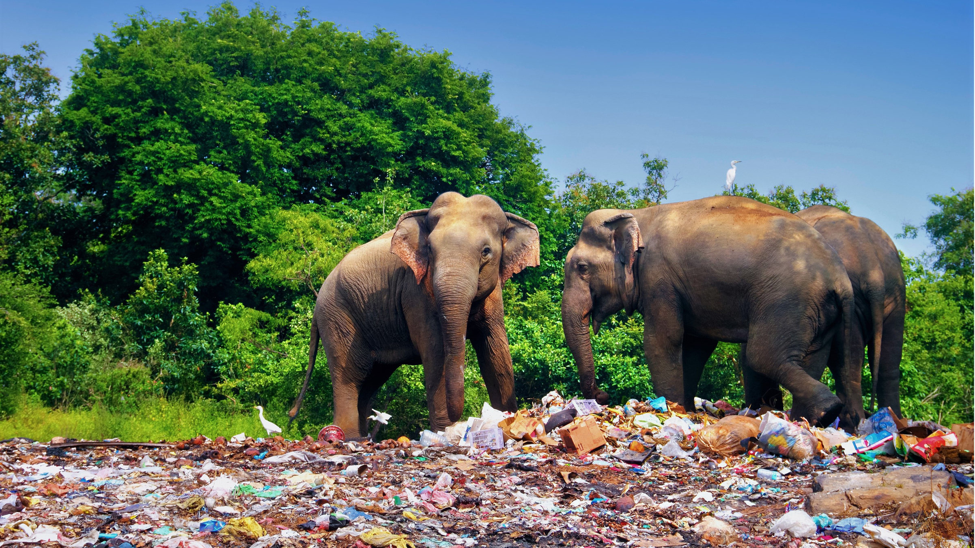
Notes:
It’s not just ocean wildlife that’s affected

Slide 6

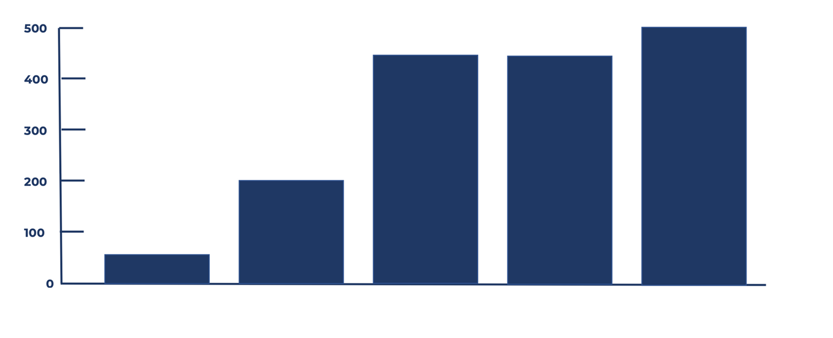
Estimated time for ’natural’ degradation
500 yrs
450 yrs
450 yrs
200 yrs
50 yrs
Styrofoam
Aluminium
can
Diaper
Plastic Bottle
Plastic Toothbrush
Source: NOAA / Woods Hole Sea Grant
Notes:
Here you can see how long it takes for different types of plastic to break down.
50 to 500 years.
SOMETHING MUST BE DONE! – and we do have a solution

Slide 7

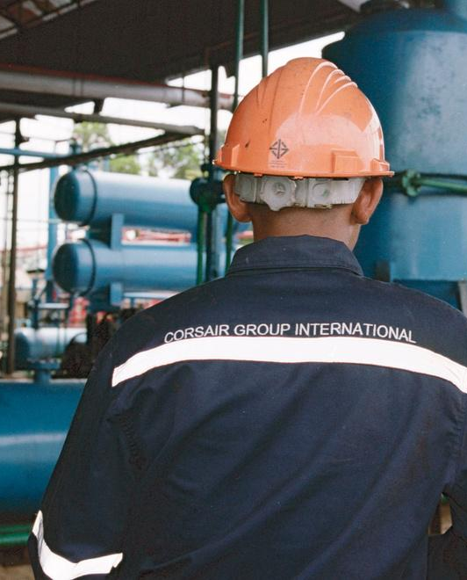


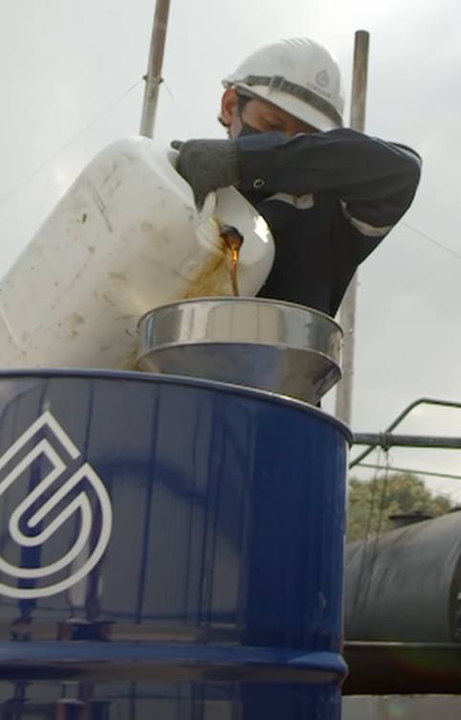
SOLUTION
Corsair Group International
TURNING WASTE PLASTIC INTO ADVANCED PYROLYSIS OIL
A Sustainable Solution for the Planet!
Notes:
Corsair Group International transforms plastic waste into advanced pyrolysis bio-oil
Instead of relocating or repurposing plastic creating more and more microplastics the pyrolysis process turns plastic back into oil from which it was made in the first place – true recycling

Slide 8

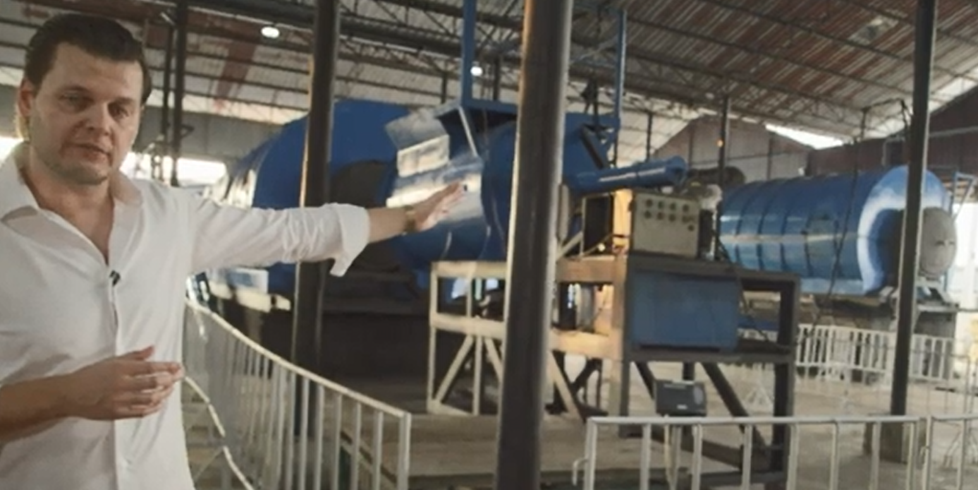
2 Units at Bangkok 1 Facility
Notes:
These are two pyrolysis recycling units – the big blue cylinders, in the facility in Bangkok with the Corsair founder Jussi Saloranto
Pyrolysis is a process of heating the waste plastic in the absence of Oxygen, so it doesn’t burn resulting in the oil and gas which is used to fuel the heating process itself.

Slide 9

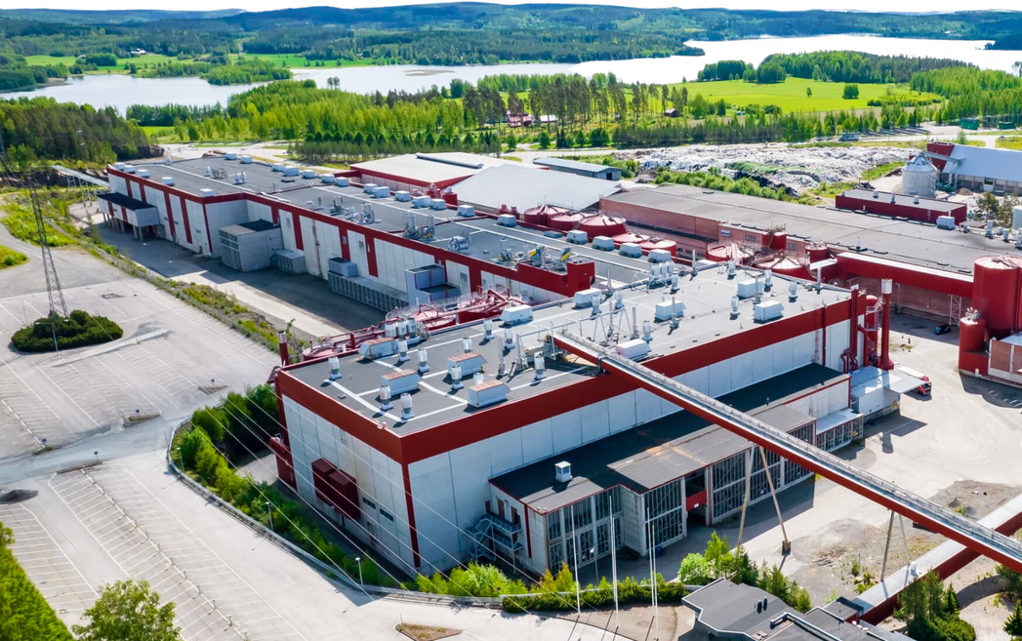
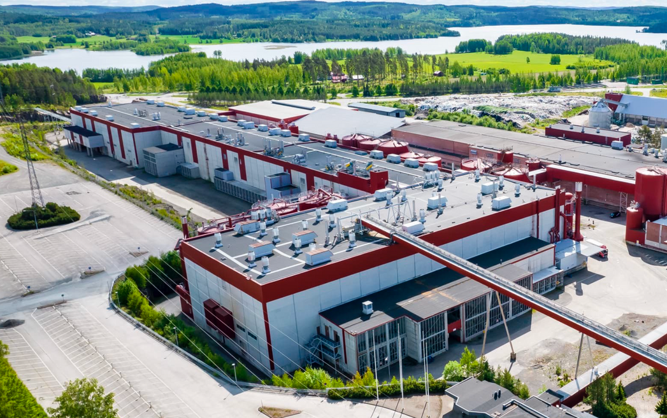
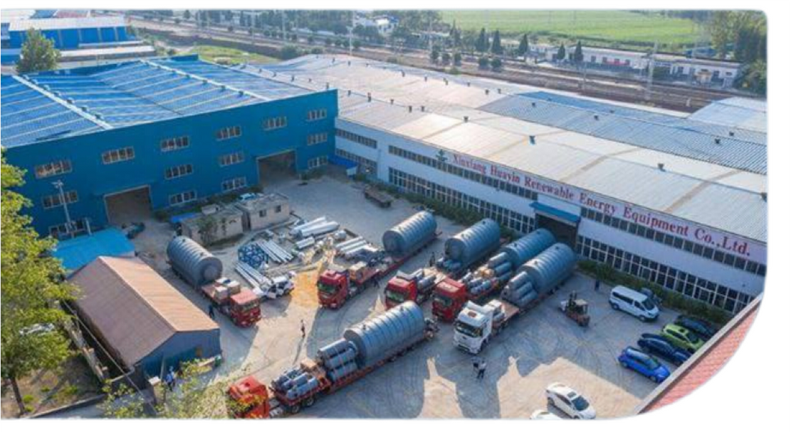



EUROPE
CORSAIR
FINLAND
1 OPERATIONAL UNIT
3 units in installation phase,
10 units up and running in 2025
OPERATIONAL AREA
59.000 sq metres
CAPACITY 50 UNITS
45 million litres/year
Notes:
Closer to home Corsair are currently operating in Finland dealing with waste from Europe and Scandinavia

Slide 10
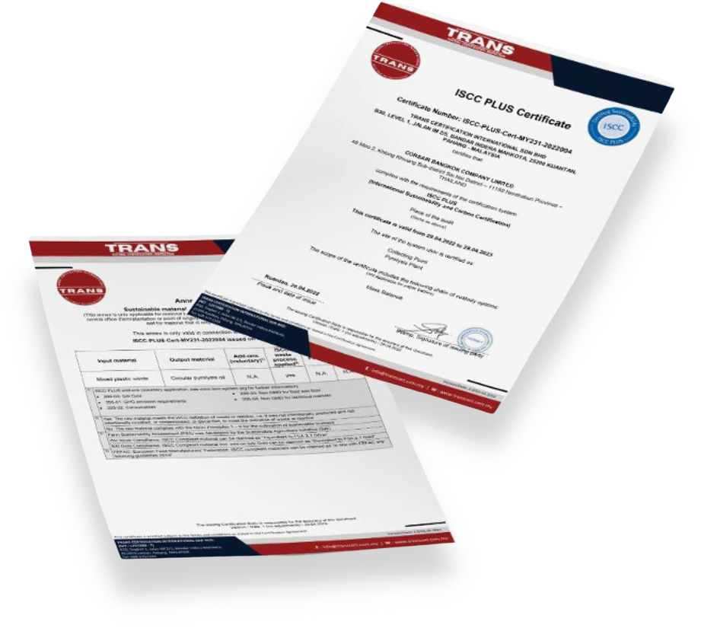

CORSAIR IS ELIGIBLE FOR ISCC PLUS CERTIFICATION
This prestigious certification ensures and verifies that a company meets globally recognised environmental and social sustainability requirements.
Oil companies must buy from
ISCC certificated companies
Companies that use plastic in their production are required by law to use
30% recycled plastic in the manufacture of new plastics.
So there is a huge demand for advanced Bio oil!
Notes:
Just like the processes for dealing with Carbon, carbon credits and carbon neutrality the recycling of plastic also has to be certified.
Companies who buy the pyrolysis oil must use a validated source and are required by law in an increasing number of jurisdictions, particularly the EU and soon the UK to do so

Slide 11
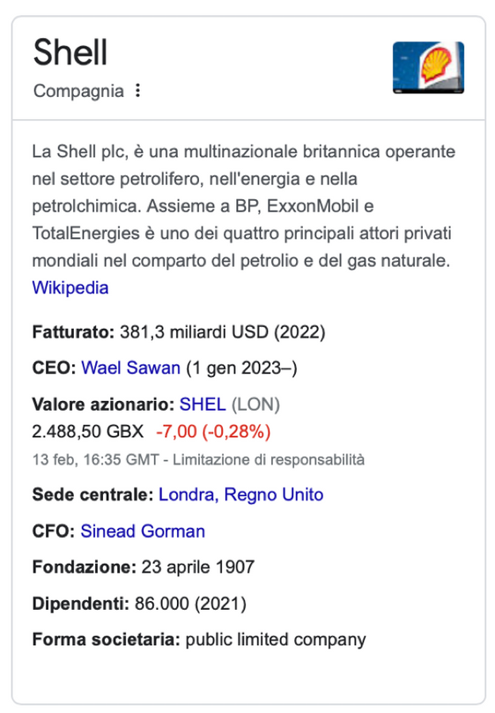
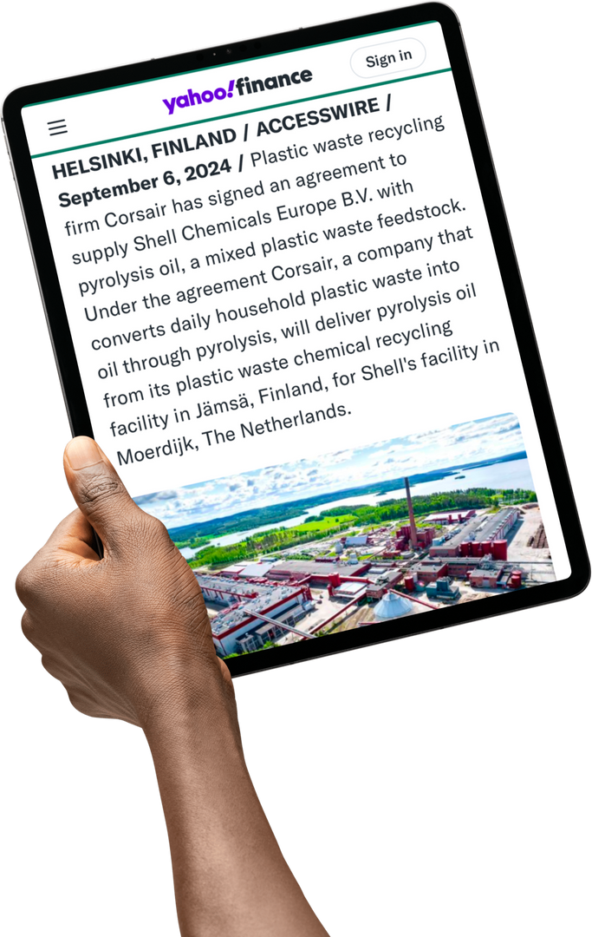


Clients & Partners
CORSAIR GROUP
OFFICIAL SUPPLIER
SHELL EUROPE & ASIA
CORSAIR GROUP INTERNATIONAL
has been selling its pyrolysis oil to
SHELL SINGAPORE LTD
& SHELL CHEMICALS EUROPE
since 2024
Notes:
Corsair group has now been supplying Shell with oil for 2 years

Slide 12
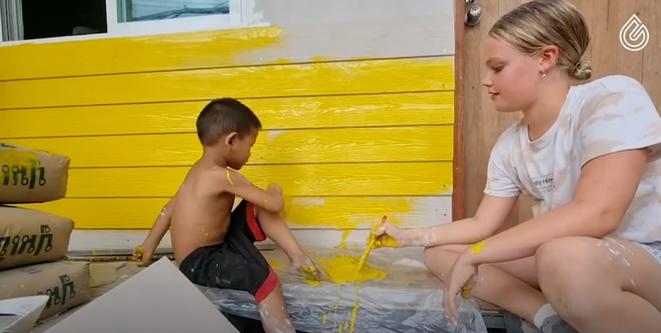
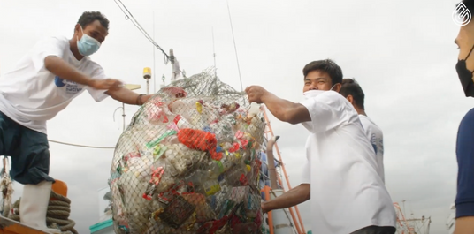
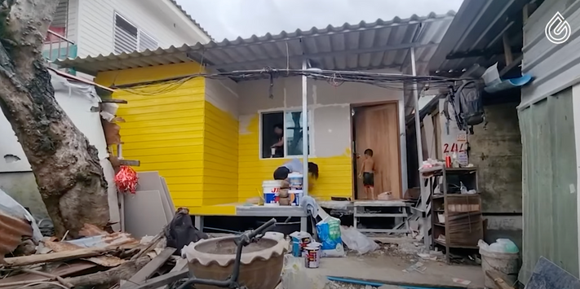

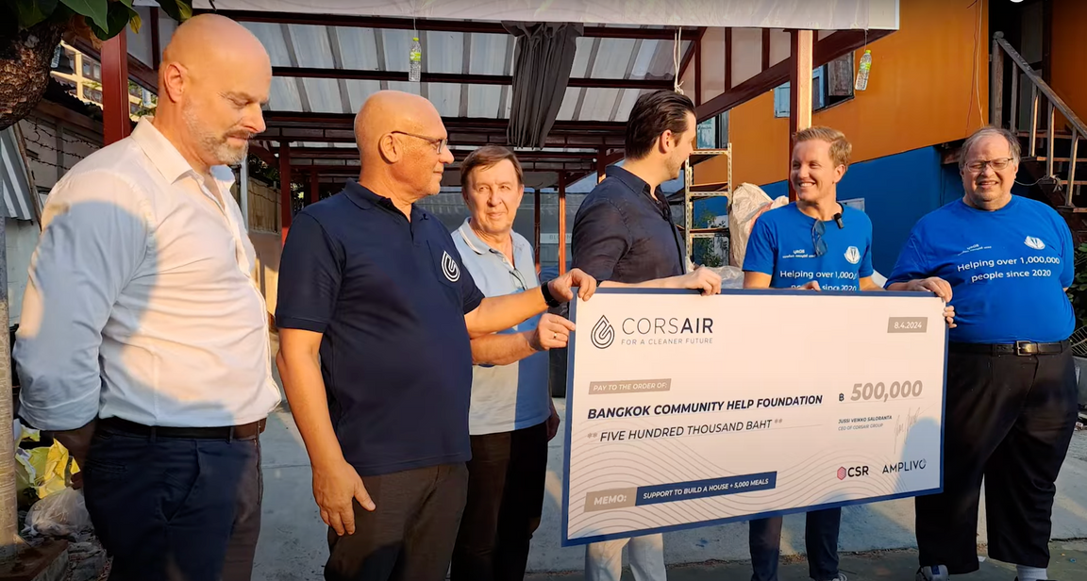
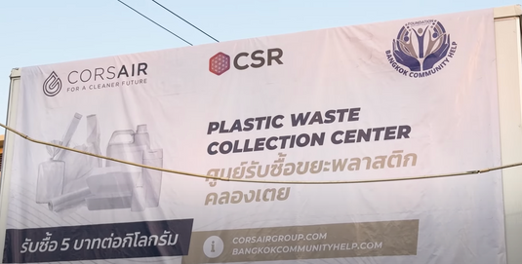

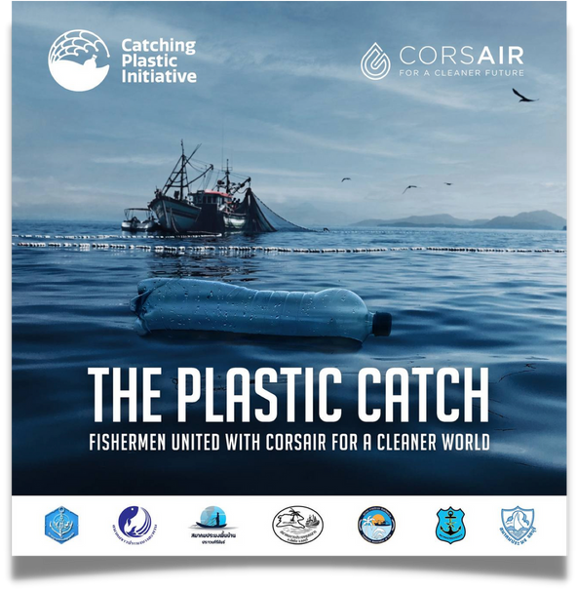
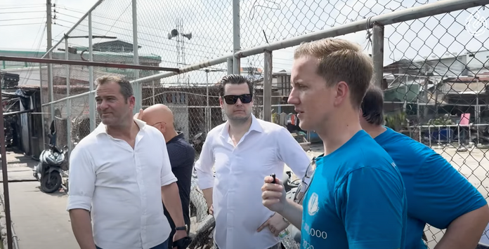
INITIATIVES
CORSAIR
FOUNDATION
BANGKOK COMMUNITY HELP
We support people living in extreme poverty conditions by giving them food and funding homes where they can live.
THE PLASTIC CATCH
In collaboration with 7 Thai fishing associations (100,000 fishermen), we collect plastic waste from the oceans.
TRASH 4 CASH
We donate money in exchange for plastic waste collected in the poorest areas of Thailand
Notes:
Corsair help the local communities as well. I remember as a kid collecting discarded glass bottles and taking them back to the shops to get a few pence (old pence) reward. Corsair are now paying people in Thailand to bring in their waste plastic and encouraging fishermen to stop throwing the plastic back in the sea but bring it back where they can make almost as much money from the plastic as they do from the fish!

Slide 13
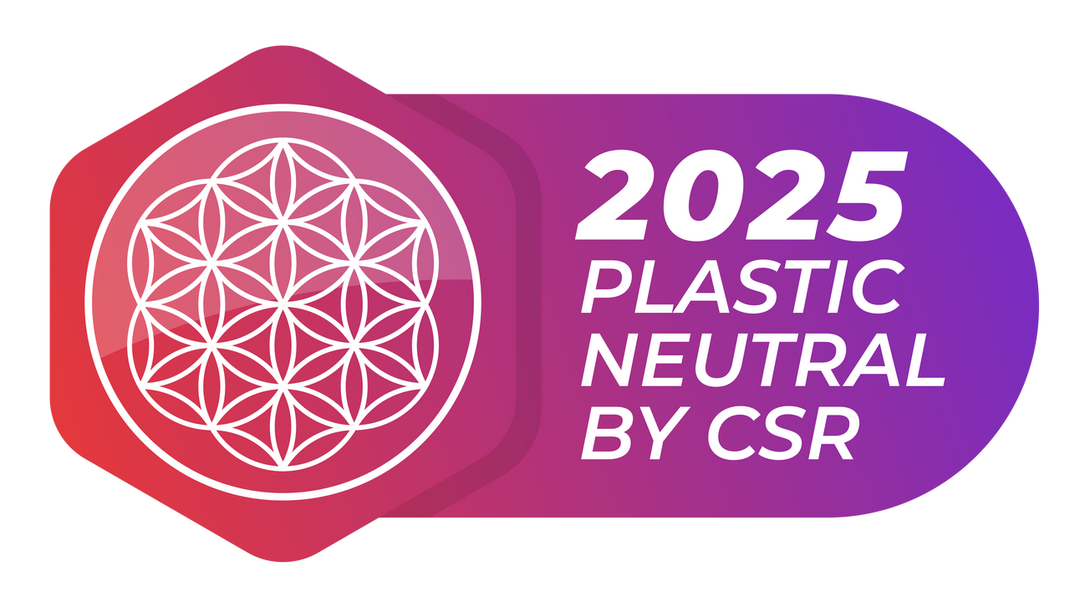

What are
CSR PLASTIC CREDITS?
They are a digital receipt - recognized worldwide -
that certifies the removal of plastic waste from the environment.
They operate on an open source, highly transparent and reliable database called blockchain.
Every CSR and every transaction is publicly recorded and can be viewed by anyone.
Notes:
It’s all managed by the use of plastic credits issued by the companies who are suitably certified and verified in the recycling effort, Corsair issue the CSR a digital receipt underpinned by blockchain technology which proves the recipient has caused (by paying Corsair to do so) the removal of plastic waste from the environment

Slide 14
What are they ‘worth’?
Today’s standard price for a CSR25 plastic credit is $0.046
To officially achieve plastic neutrality a person or company holding these credits has to ‘retire’ them thus removing them from the market
Whenever this happens the value of the remaining tokens increases
If you hold more CSR25s than you need to be certified neutral the surplus credits can be sold on the open market at a higher rate than that at which they were purchased due to ever increasing demand

Slide 15



WHAT YOU CAN DO
FOR THE PLANET
Today, thanks to CORSAIR Group International, individuals and companies can offset their plastic pollution.
For purchasing a ‘Plastic Waste Removal Package’ (also known as a Plastic Neutrality Package – PNP) from CORSAIR you receive CSR25 Plastic Credits in return
Notes:
The thing is, if you buy a ‘Plastic Removal Package’ or Plastic Neutrality Package’ from Corsair through their marketing arm Amplivo you receive CSR plastic credits in return,. Currently they are labelled CSR25, next year will be CSR26 because removal of plastic waste is an ongoing process with around 30 years worth to remove before we even start on the plastic thrown away today

Slide 16
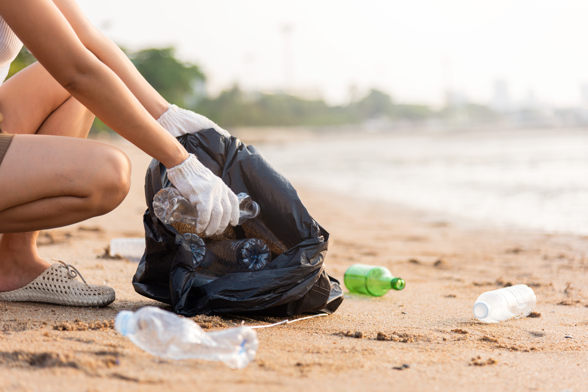

HOW YOU CAN BECOME
PLASTIC NEUTRAL
1.
CORSAIR recycles plastic waste worldwide through certified supply chains
2.
For every KG of recycled plastic, Corsair releases 10 CSR25 Plastic Credits into the market.
Individuals and companies purchase the plastic waste removal service to offset their own plastic pollution.
Example: 1.000 Kg = 10.000 CSR25
3.
Notes:
W buy plastic credits not for our own plastic waste we create today but to clear the backlog of global accumulated waste

Slide 17
WHAT’S YOUR
PLASTIC FOOTPRINT?
Every Individual (on average) is ‘responsible’ for at least 50KG of waste plastic per year
That’s 1KG per week or more for every adult and child
This is just the plastic you ‘throw away’ – look around you and see how much plastic you ‘keep’ – greatly increasing your plastic footprint
Remember, this dates back to around 1960 – how much plastic waste have you been responsible for since then? If you are 40 years of age its 2000KG!

Slide 18

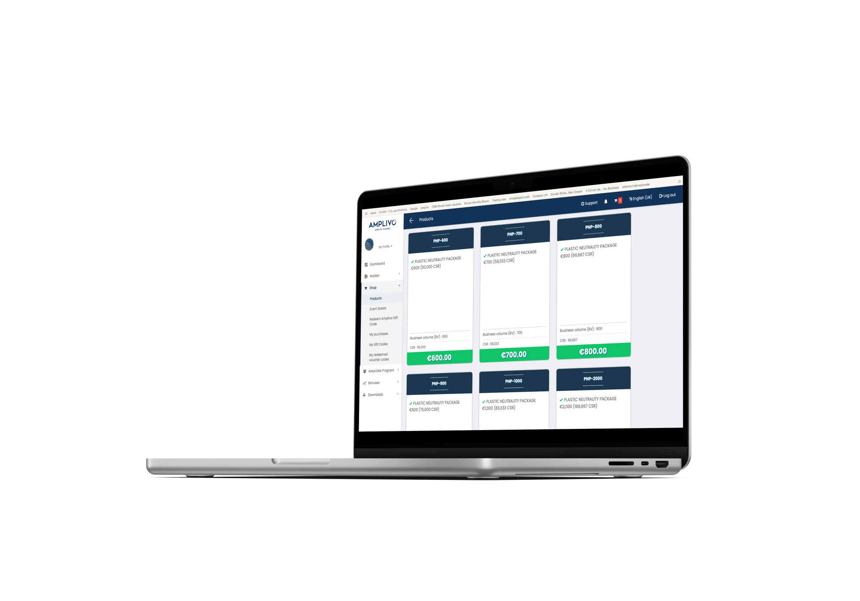

HOW TO OBTAIN CSR25 PLASTIC CREDITS - 1
From the AMPLIVO NETWORK through Plastic Neutrality Packages (PNP) “Plastic waste removal service”
(Always at a lower price than the open market)
WHEN and HOW ARE THEY DISTRIBUTED?
In 20 months CORSAIR will recycle the plastic specified in the chosen package.
and will gradually deliver CSR25 Plastic Credits.
Notes:
You or a company you know can become plastic neutral, with a certificate to prove it by purchasing a package, starting as little as 10 Euros – it’s a European company so everything is in Euros, one Euro at the moment being about 85p.
It takes 20 months at the moment from the initial collection of the waste to go through the process and then for Corsair to receive payment for the pyrolysis oil. Your plastic credits are fed through gradually over that period. It will come down significantly as Corsair build more facilities and populate them with pyrolysis units

Slide 19

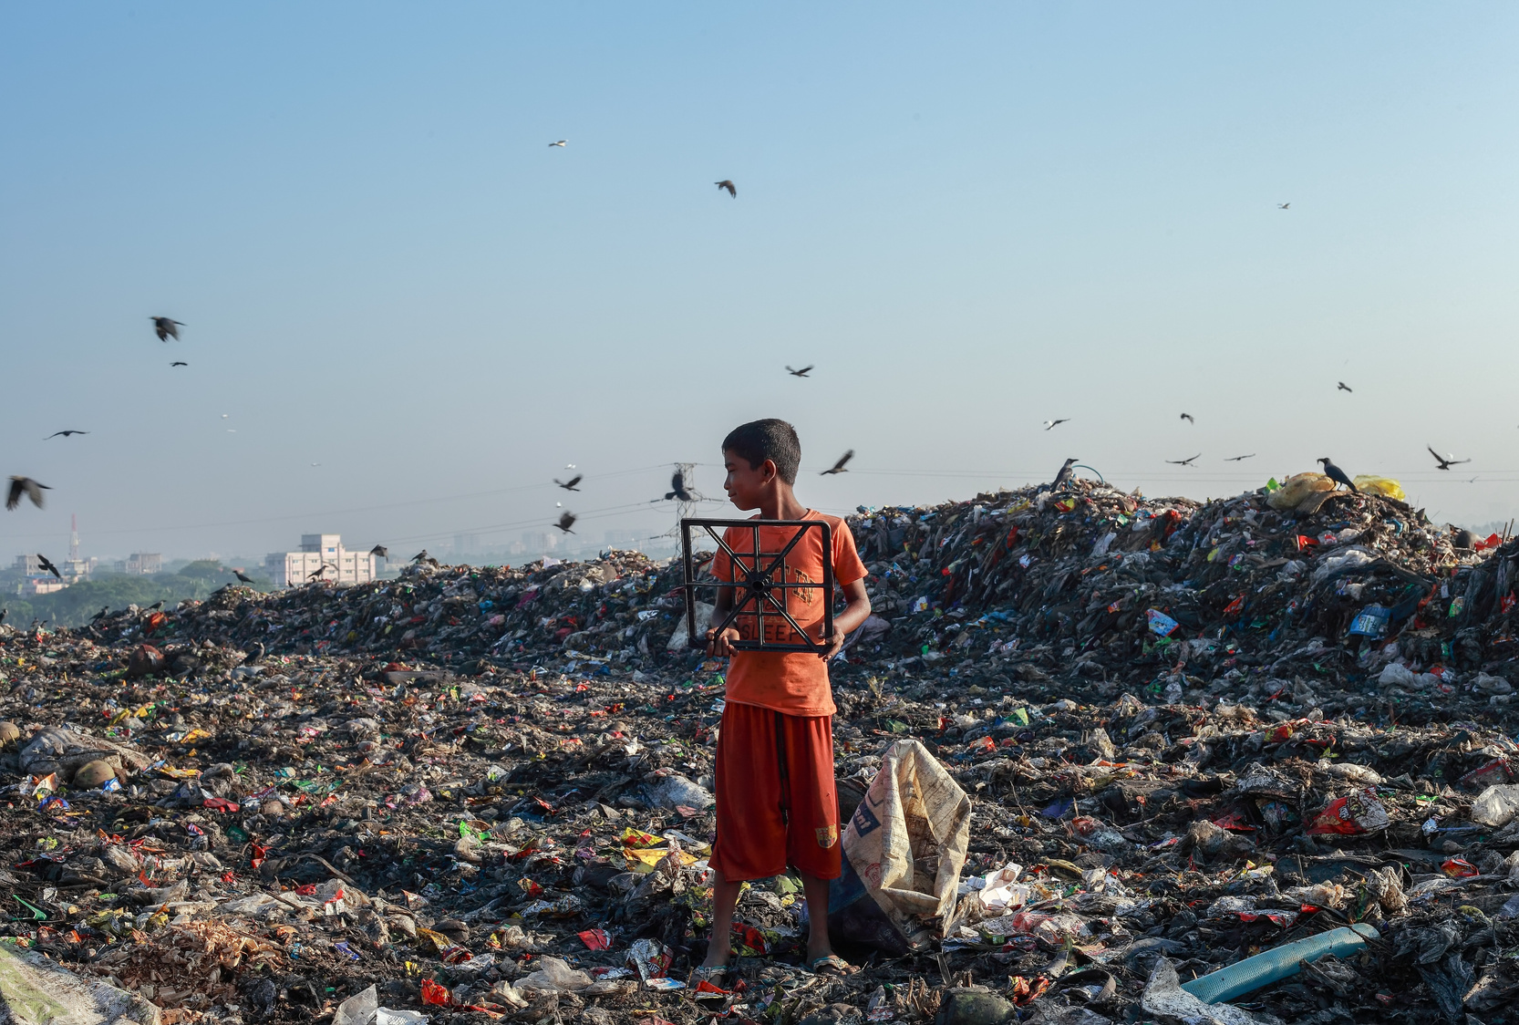
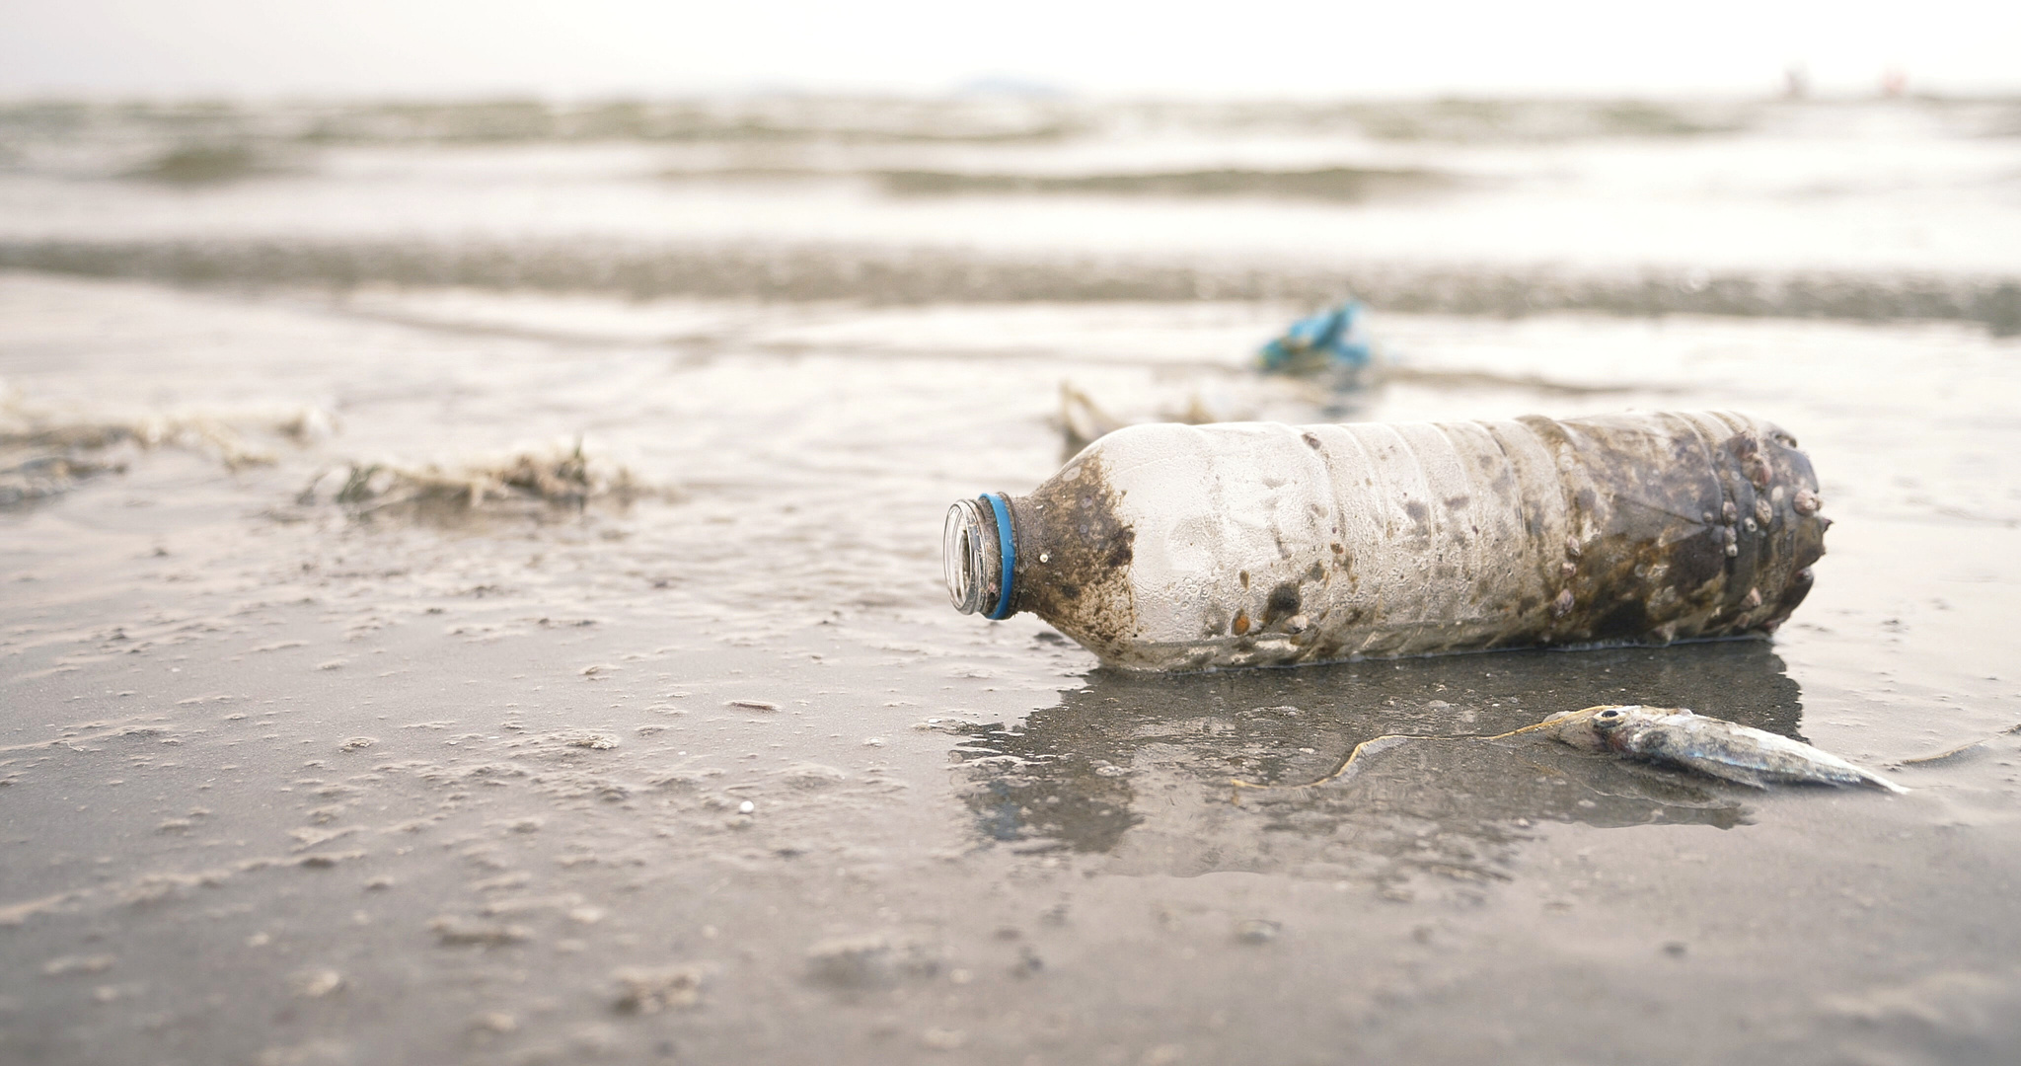
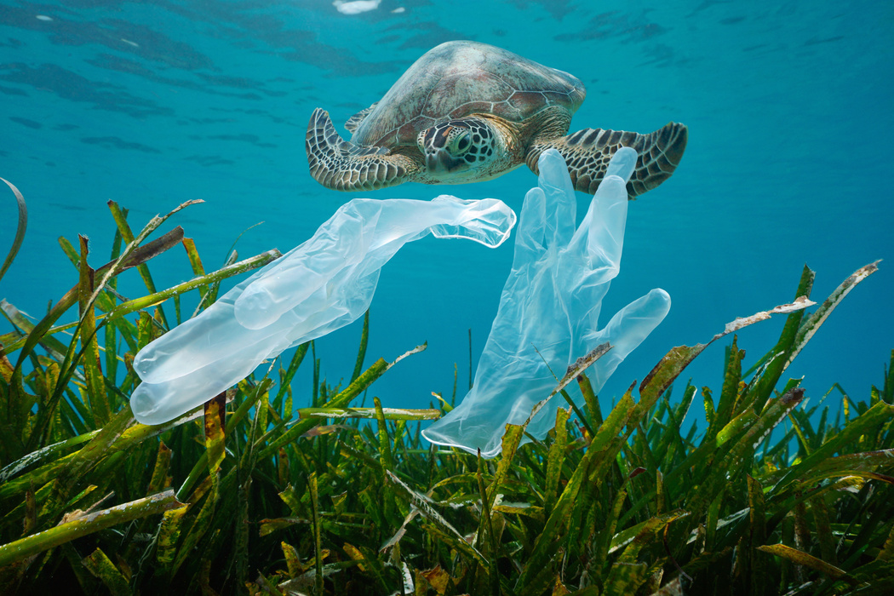
JOIN THE
MISSION!
  Help clean our planet from plastic
  Be part of this world-leading company
  Amplivo Associates are active in dozens of countries worldwide
  An ethical and exclusive business, unique in the world.
  For more information Contact me direct
  ben@bencoker.net
Notes:
Register with Amplivo to get started, learn more and help spread the word. Contact me direct for more information

