Slide 1



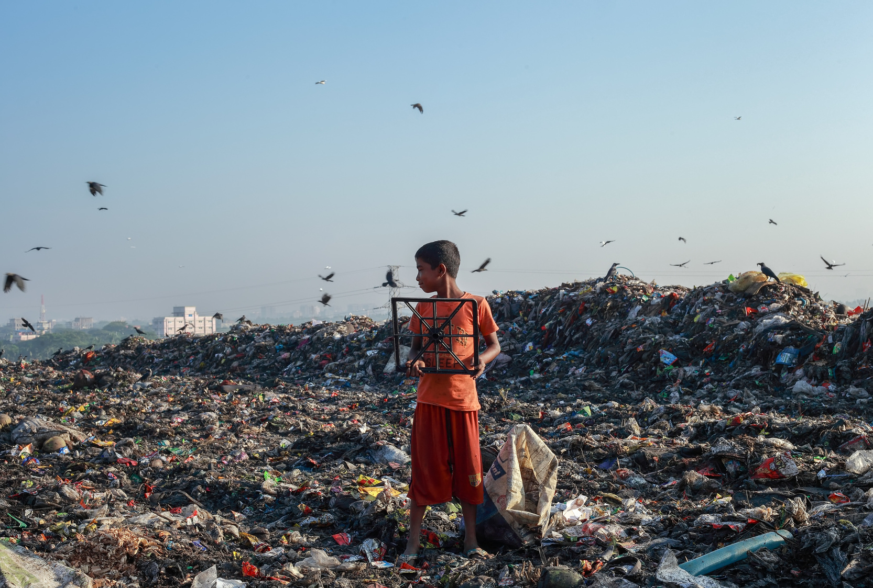
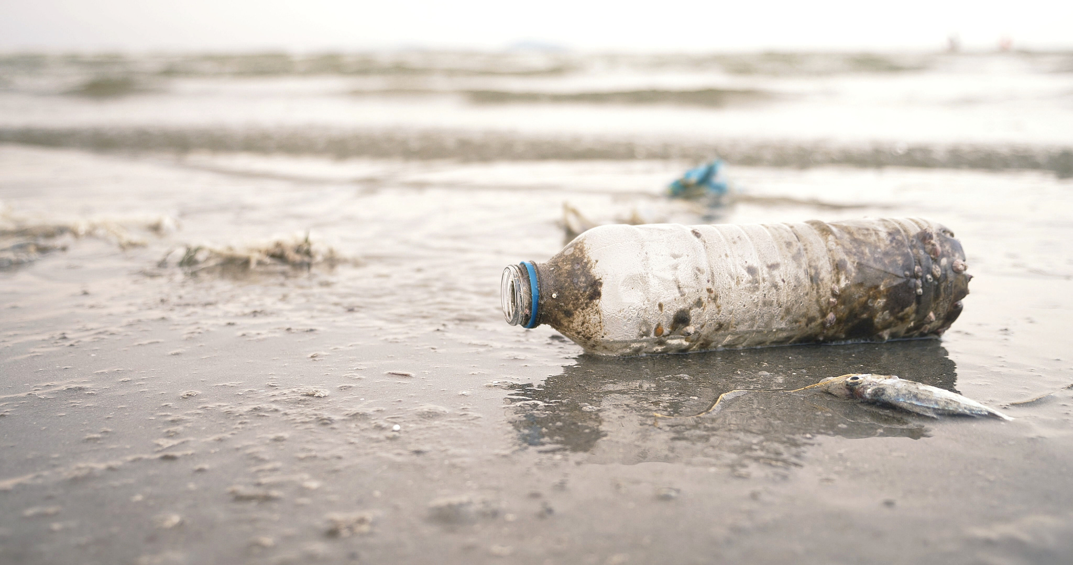
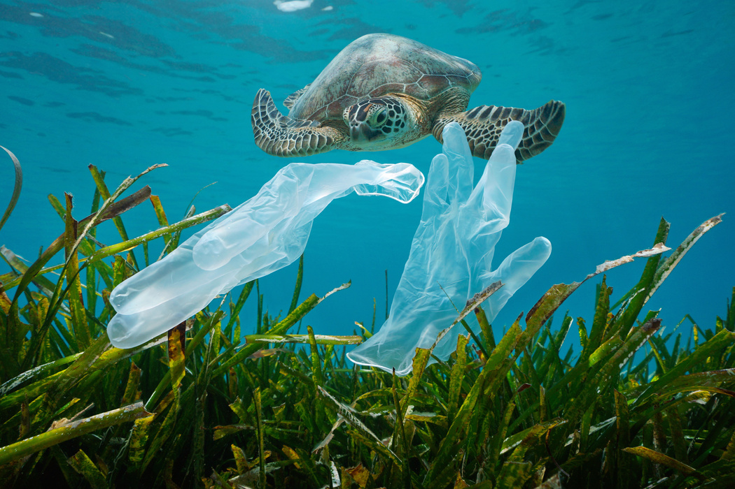
.
WELCOME

Slide 2

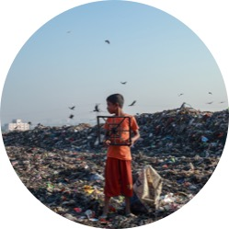


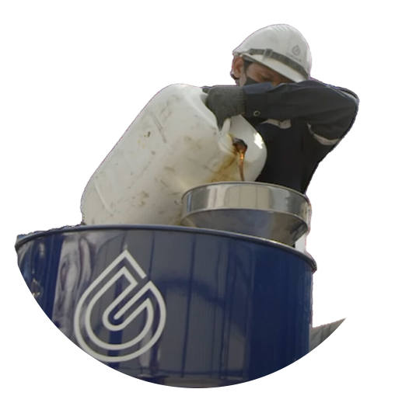
What we will see
In this presentation – or next time
PROBLEM
SOLUTION
VERIFICATION
OPERATION
PLASTIC POLLUTION
CORSAIR GROUP
INTERNATIONAL
CSR PLASTIC CREDIT
CORSAIR/AMPLIVO

Slide 3



What is a PLASTIC CREDIT?
Notes:
Now we’ll look at what the ‘CSR’ is all about

Slide 4




It is a transferable unit,
Representing a specific amount of plastic collected from the environment
and possibly recycled.
www.worldwildlife.org/publications/wwf-position-plastic-crediting-and-plastic-neutrality
WWF DEFINITION OF
PLASTIC CREDIT
Notes:
Explain use of possibly with ref to repurposing and relocation
Note this is NOT the Corsair definition of CSR25

Slide 5

What are
CSR PLASTIC CREDITS?
They are a digital receipt - recognized worldwide -
that certifies the removal of plastic waste from the environment.
They operate on an open source, highly transparent and reliable database called blockchain.
Every CSR and every transaction is publicly recorded and can be viewed by anyone.
Notes:
Explain the Blockchain

Slide 6
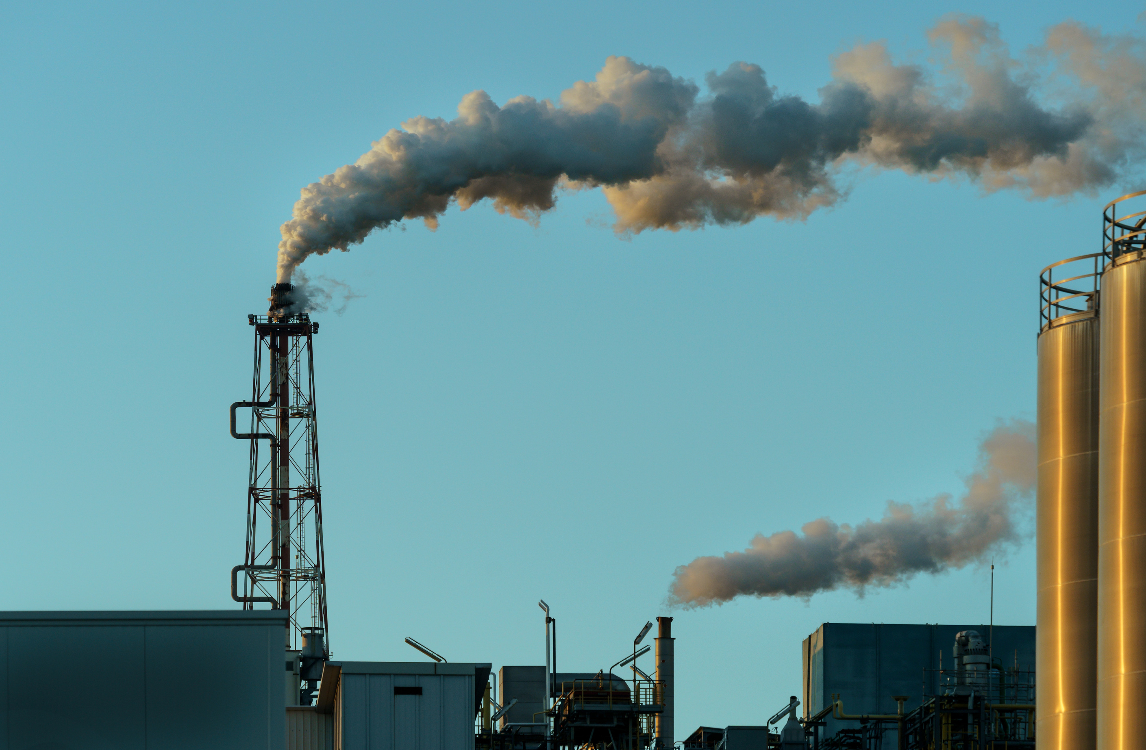



To understand the potential of this company it is
essential to take a step back…
CARBON CREDITS MARKET
It was born in the Kyoto protocol of 1997
reducing greenhouse gas emissions with the aim of neutralising Carbon Dioxide production
The new Plastic Credits market ‘matches’ Carbon Credits with which individuals and companies can
neutralise their plastic pollution.

Slide 7

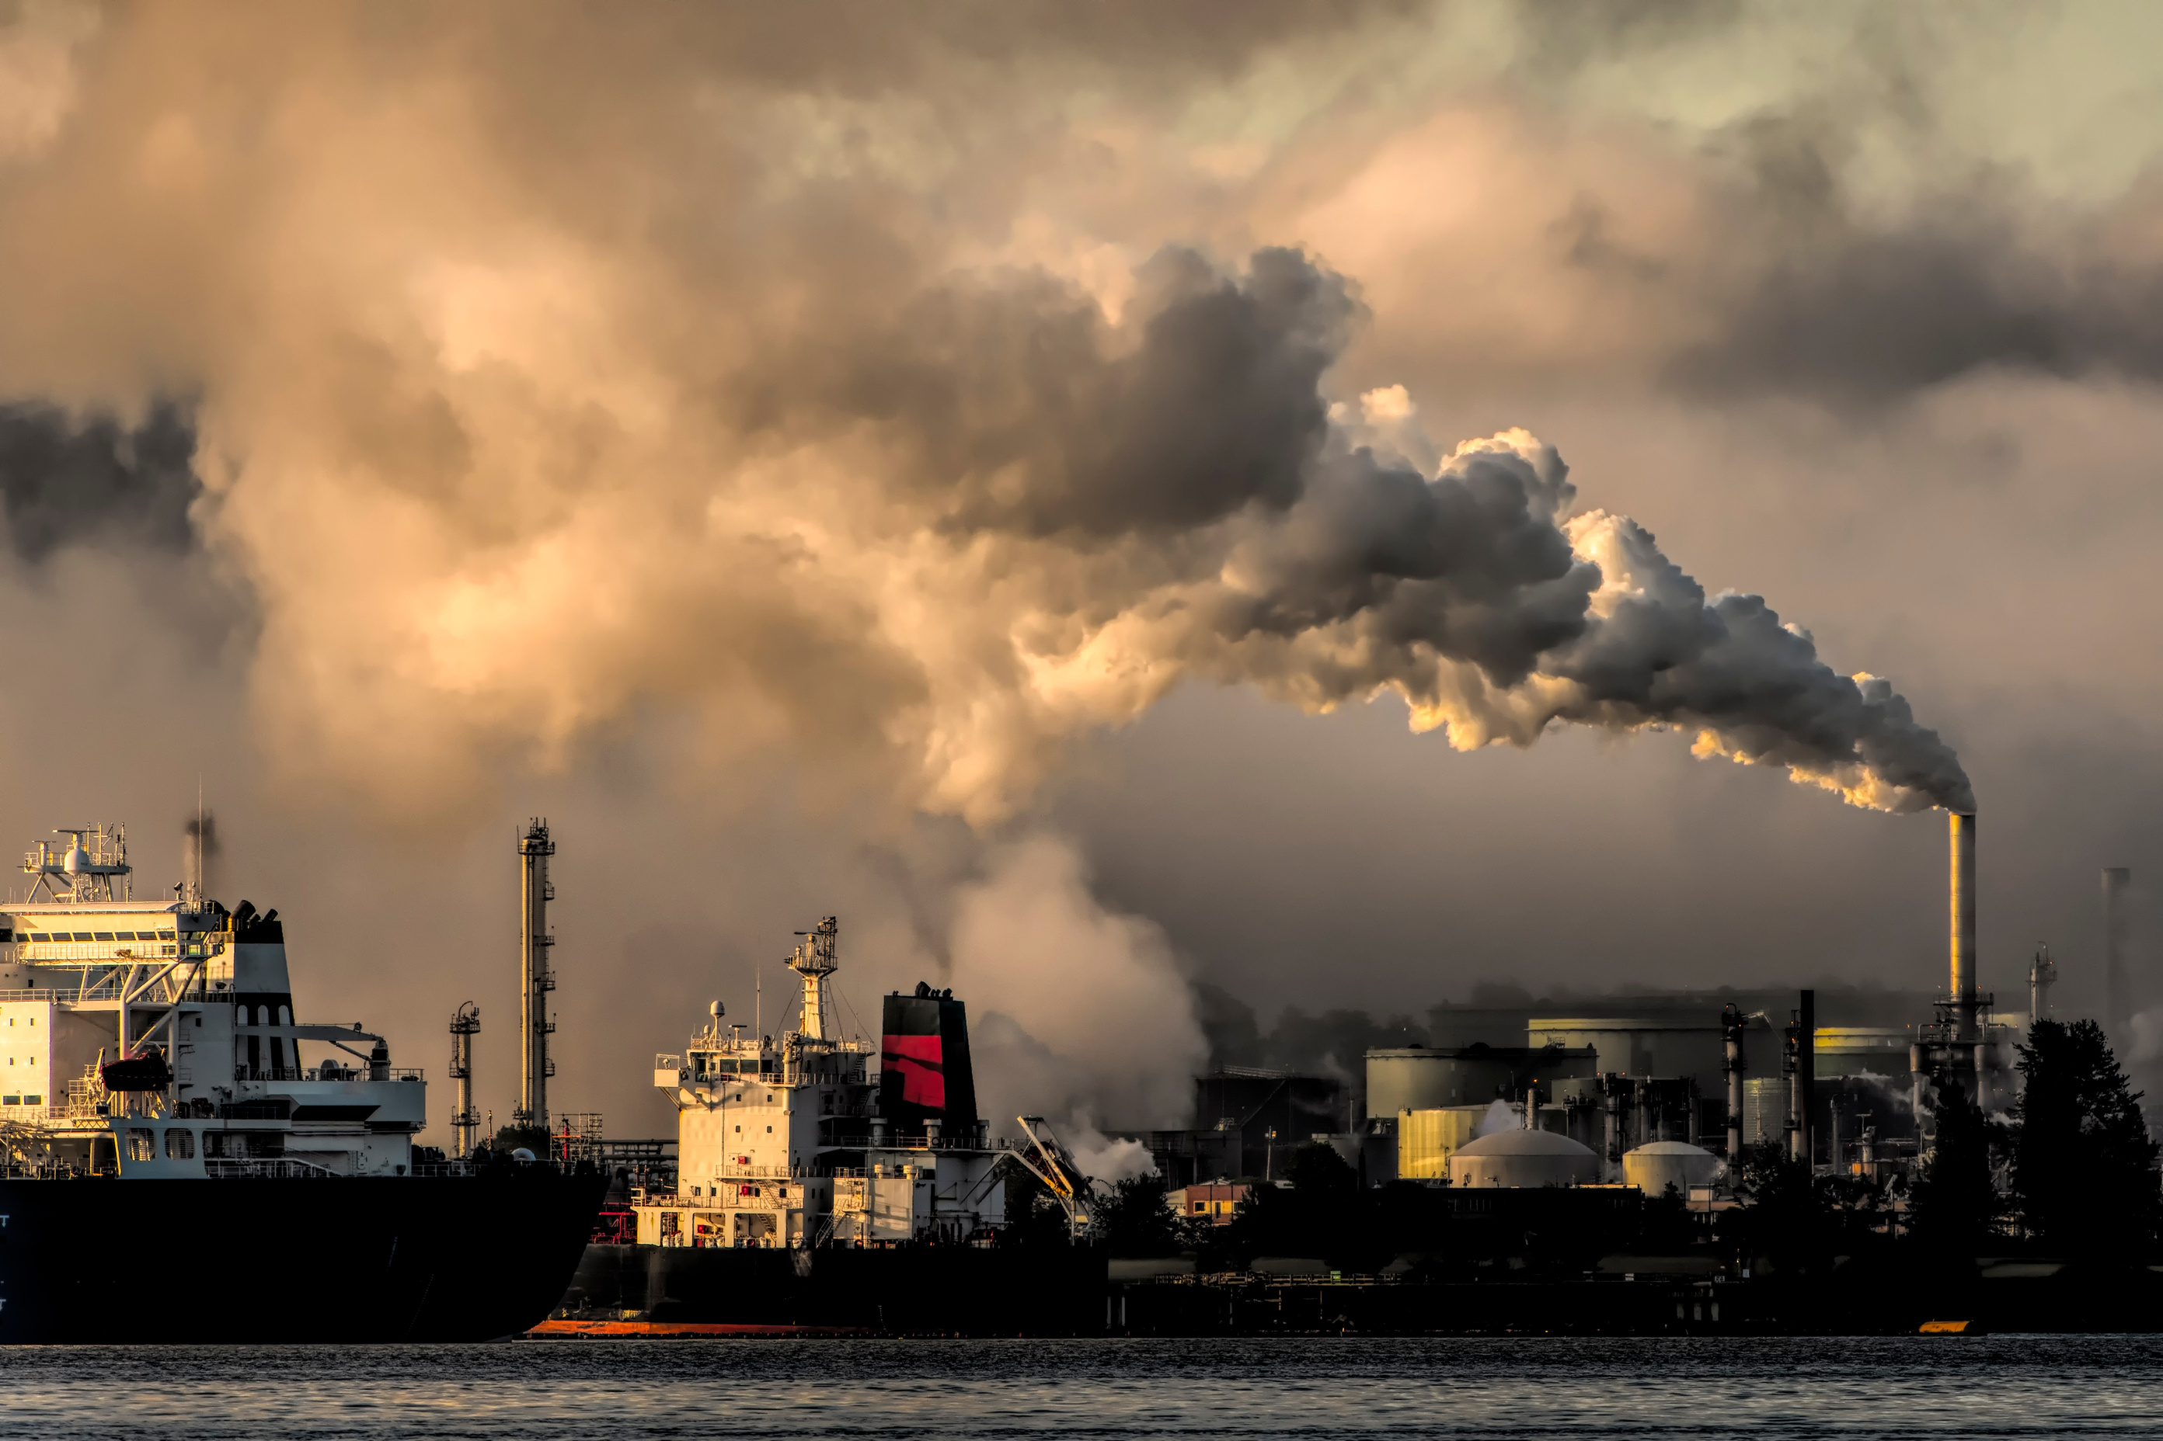





$1.4 TRILLION
Was traded inside the Carbon Credit market in 2024 alone (estimated at $2.3 trillion in 2028)
https://www.msci.com/www/blog-posts/frozen-carbon-credit-market-may/05232727859

Slide 8
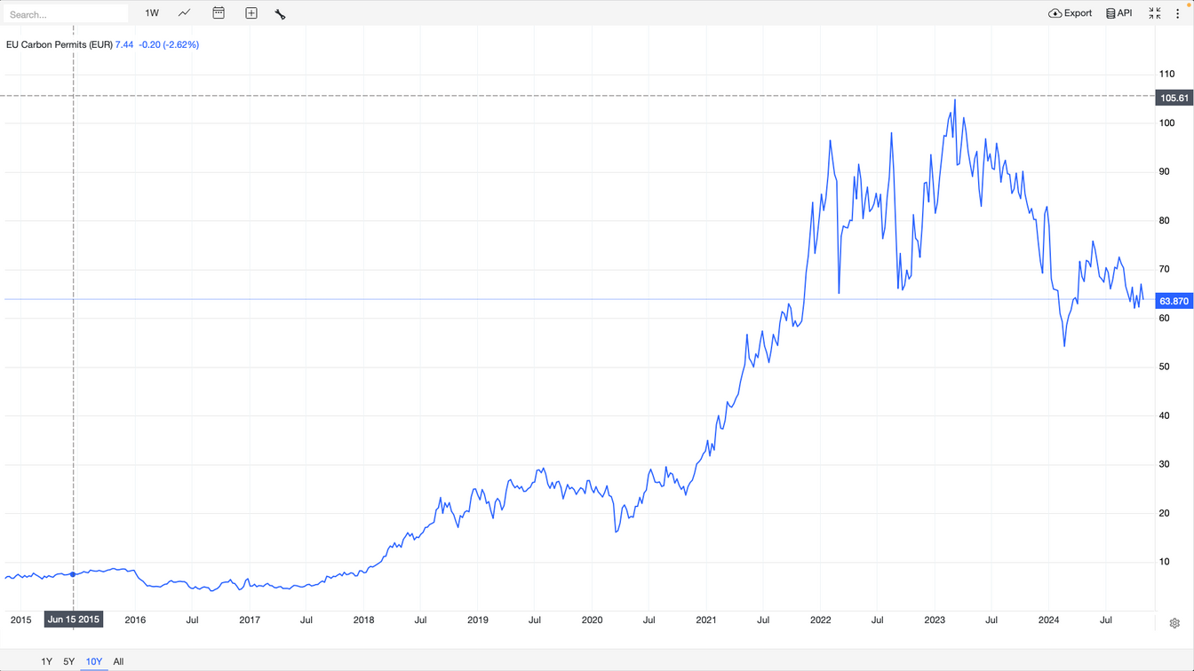
Offsetting 1 ton of CO2 through Carbon Credits in 2005 cost around $5. Today the same certification costs more than $60.
Fonte: https://tradingeconomics.com/commodity/carbon
Notes:
20 years on the same is likely to happen with Plastic Credits – but quicker

Slide 9
MARKET PROJECTIONS
By 2027/28 the Plastic Credits market will be
10 % of the Carbon Credits market ($230 billion plus).
CORSAIR GROUP INTERNATIONAL
Today, CORSAIR is the world leader in the Plastic Credits market.
By 2027/28, with just 10% of this market, Corsair could reach an
annual turnover of $23 billion.
Notes:
This is all very well – but what about funding. Here’s where Corsair have been imaginative – talk about VC and IPO options then into Crowdfunding

Slide 10
TODAY THE CSR PLASTIC CREDIT
is a WORLD LEADER in PLASTIC NEUTRALITY CERTIFICATION

Slide 11
How does it work?
Where does the money come from?
Notes:
Now we’ll look at what the ‘CSR’ is all about

Slide 12
FUNDING OPTIONS FOR CORSAIR
VENTURE CAPITAL
 Loss of control, potential takeover and repurposing
STOCK MARKET FLOTATION
 Loss of control, uncertainty, fluctuation of market
STRUCTURED CROWDFUNDING
✓ Maintain control & flexibility, popular ownership

Slide 13


WHAT YOU CAN DO
FOR THE PLANET
Today, thanks to CORSAIR Group International, individuals and companies can offset their plastic pollution.
For purchasing a ‘Plastic Waste Removal Package’ (also known as a Plastic Neutrality Package – PNP) from CORSAIR you receive CSR25 Plastic Credits in return
Notes:
Explain it doesn’t have to be YOUR plastic waste
ExplainCSR 25, CSR 26 etc.

Slide 14
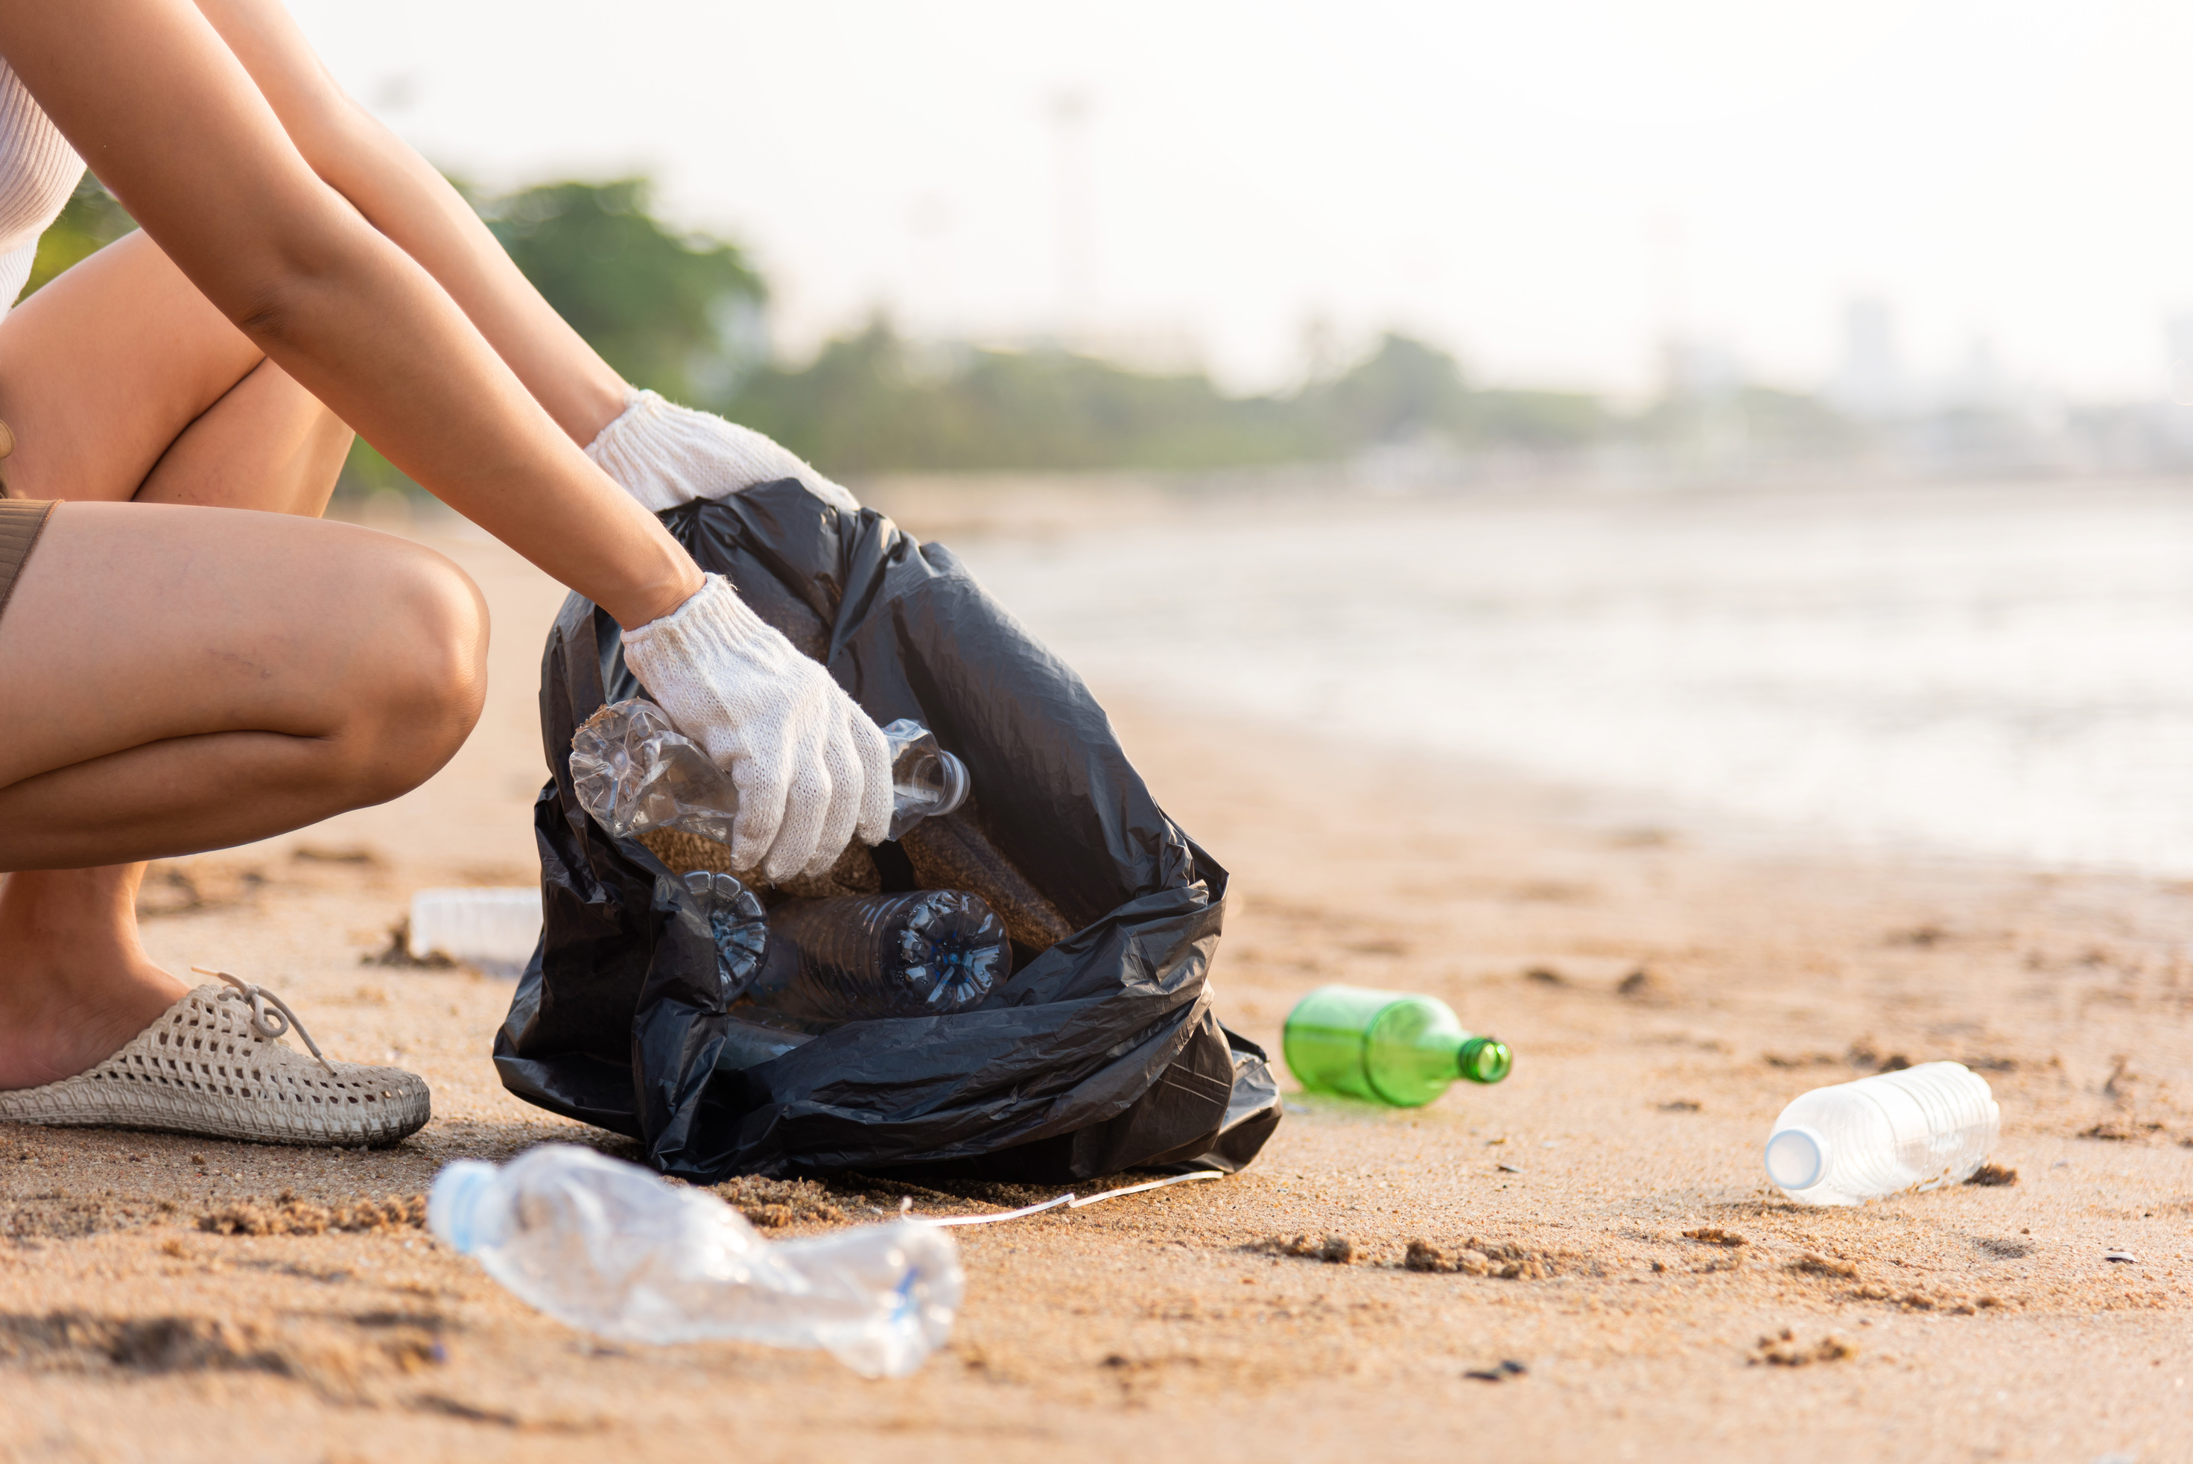

HOW YOU CAN BECOME
PLASTIC NEUTRAL
1.
CORSAIR recycles plastic waste worldwide through certified supply chains
2.
For every KG of recycled plastic, Corsair releases 10 CSR25 Plastic Credits into the market.
Individuals and companies purchase the plastic waste removal service to offset their own plastic pollution.
Example: 1.000 Kg = 10.000 CSR25
3.

Slide 15
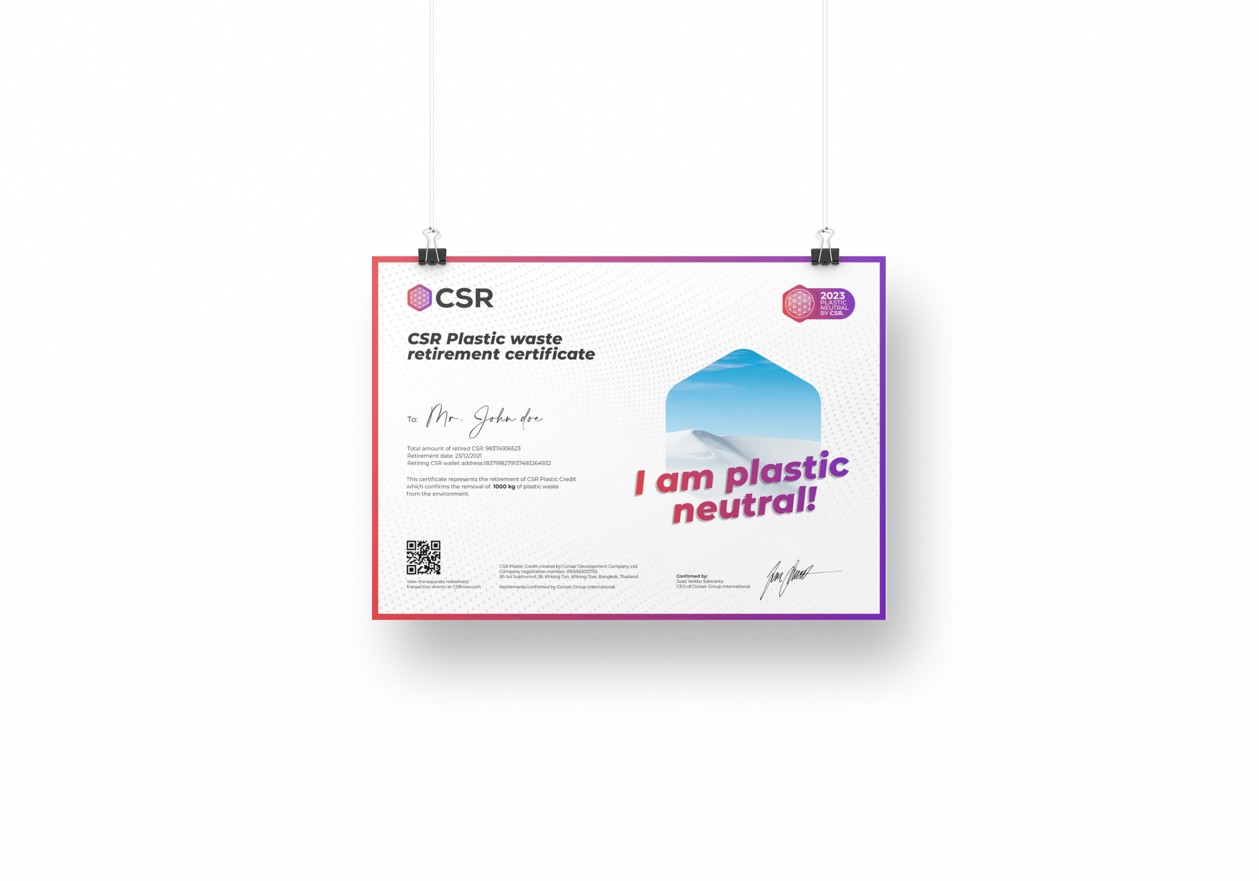



THE REVOLUTION
CSR PLASTIC CREDIT
Every time someone pays for the removal of plastic waste, (anywhere in the world) they receive plastic credits.
The CSR plastic credit is a digital receipt and asset. Proof that plastic has left the environment and been converted into advanced bio-oil.
The plastic credit is stored on a blockchain. The transactions can be verified and checked by anyone.
1 kg plastic waste = 10 CSR plastic credits
Notes:
Reminder about the Blockchain

Slide 16
WHAT’S YOUR
PLASTIC FOOTPRINT?
Every Individual (on average) is ‘responsible’ for at least 50KG of waste plastic per year
That’s 1KG per week or more for every adult and child
This is just the plastic you ‘throw away’ – look around you and see how much plastic you ‘keep’ – greatly increasing your plastic footprint
Remember, this dates back to around 1960 – how much plastic waste have you been responsible for since then? If you are 40 years of age its 2000KG!

Slide 17
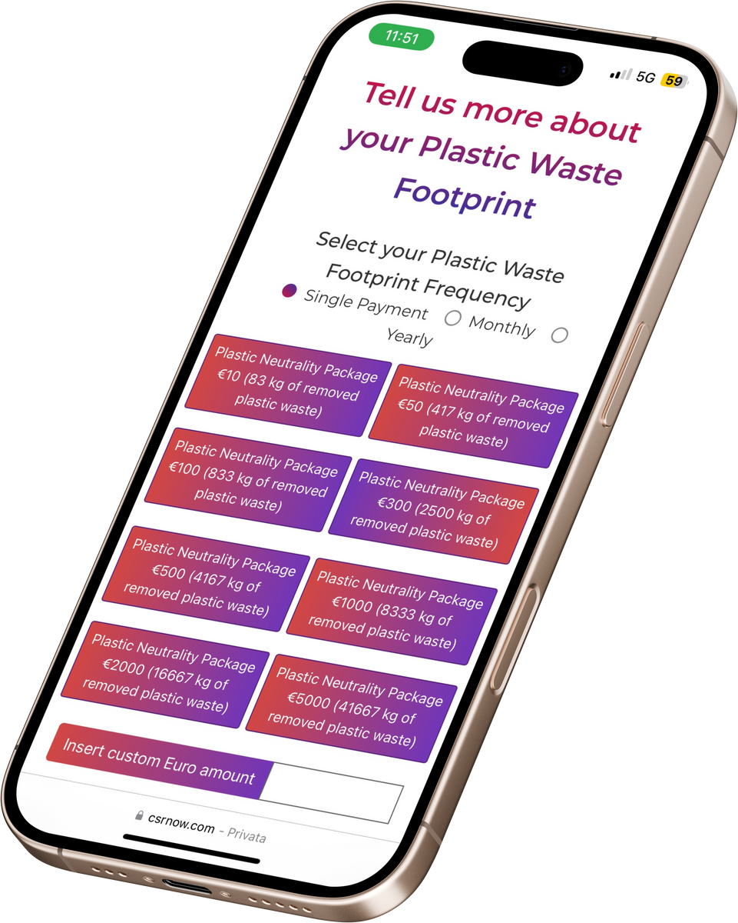
DISTRIBUTION OF
CSR25 PLASTIC CREDIT
FOR EACH KG OF PLASTIC WASTE
recycled by CORSAIR Group
10 CSR25 PLASTIC CREDITS
are released on the market
1 KG = 10 CSR

Slide 18


The process is certified by CONTROL UNION one of the WORLD'S LEADING COMPANIES in this field
They have been providing certification and inspection services to the market since 1920, with over 274 offices and laboratories in over 80 countries worldwide.
www.controlunion.com

Slide 19







GLOBAL BRANDS WHO ALREADY
USE PLASTIC CREDITS
Notes:
Not necessarily CSR – other plastic credits are available

Slide 20








INTERNATIONAL PARTNERS WHO
ALREADY USE THE CSR PLASTIC CREDIT

Slide 21
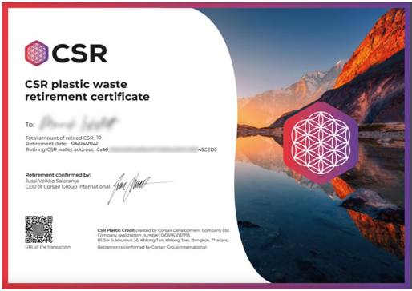

WHAT ARE THE OTHER
BENEFITS FOR A COMPANY?
1.
SUSTAINABLE BRAND
Communicate a commitment to the fight against plastic waste.
2.
TAX ADVANTAGES
The cost of this service can be deducted from the company’s expenses.
EUROPEAN AND INTERNATIONAL REGULATIONS
Require companies to create a sustainability plan, for current and future years.
3.

Slide 22

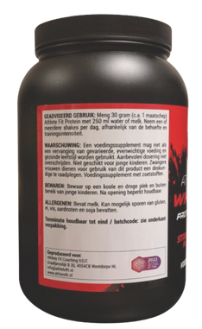
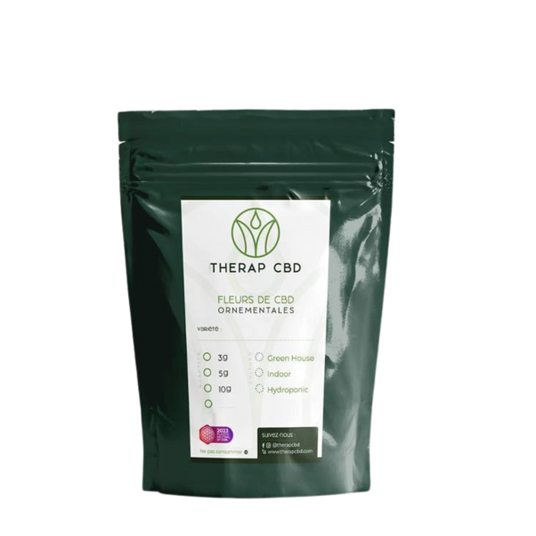






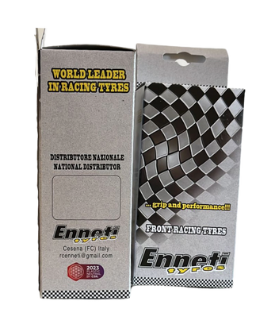
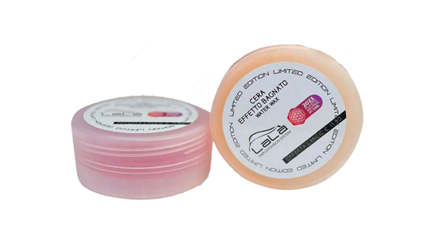
CSR LOGO
ON PACKAGING
Companies who compensate for their plastic use and become plastic neutral.
Have the right to use the CSR logo on their products.
Consumers prefer to buy products from companies that take environmental responsibility.
Notes:
Do you know a company that makes or uses plastic?

Slide 23

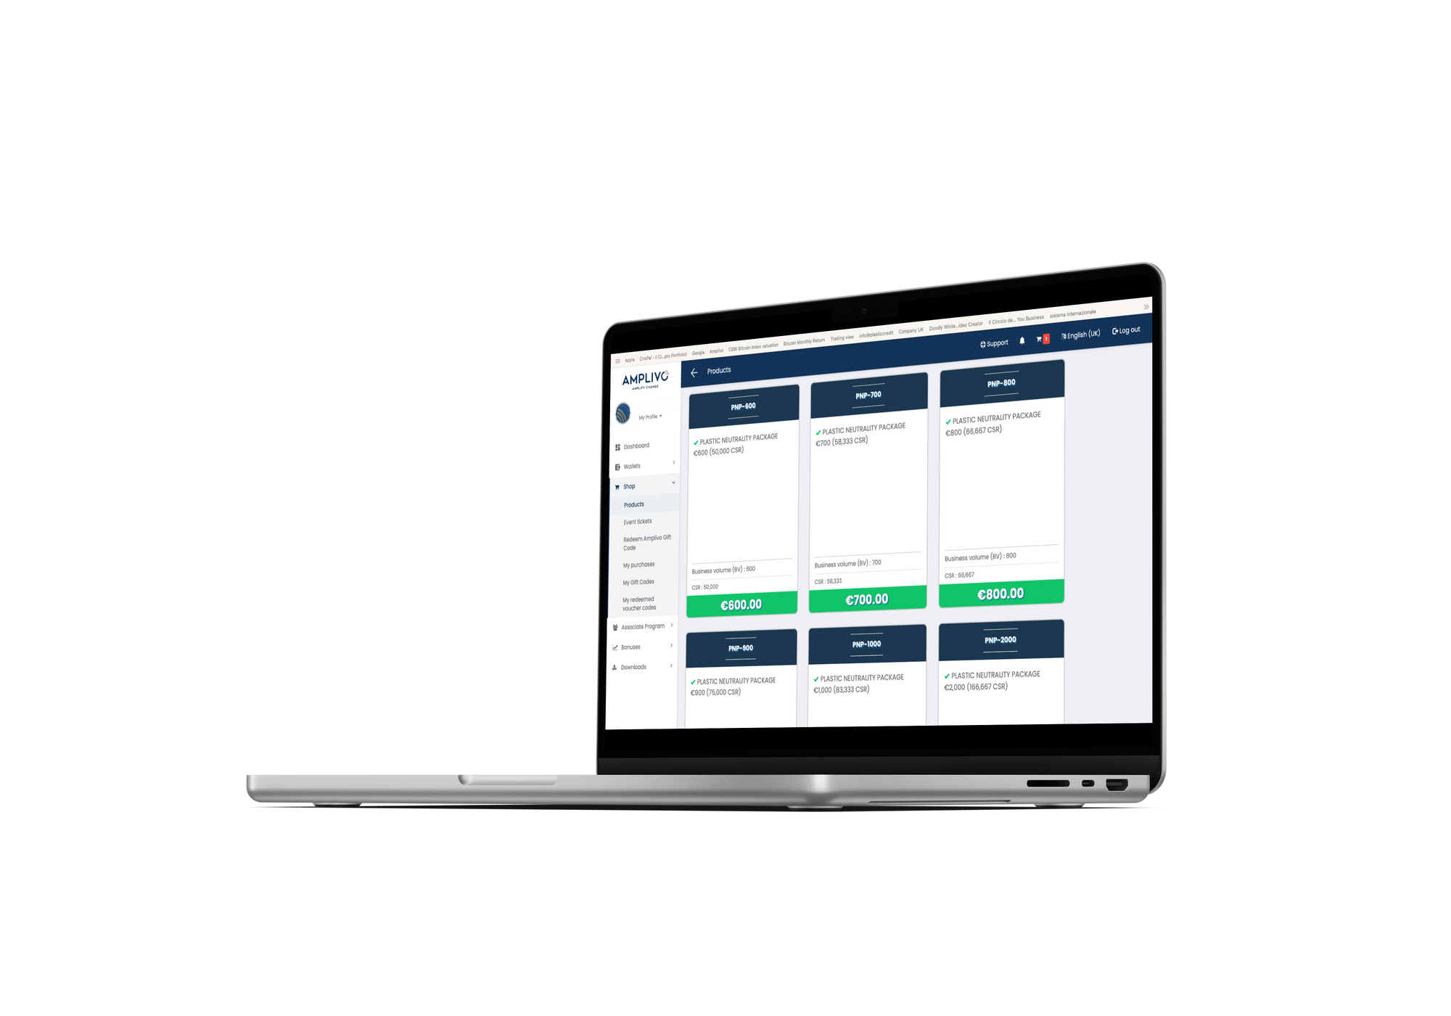
HOW TO OBTAIN CSR25 PLASTIC CREDITS - 1
From the AMPLIVO NETWORK through Plastic Neutrality Packages (PNP) “Plastic waste removal service”
(Always at a lower price than the open market)
WHEN and HOW ARE THEY DISTRIBUTED?
In 20 months CORSAIR will recycle the plastic specified in the chosen package.
and will gradually deliver CSR25 Plastic Credits.
Notes:
20 months 1 year 8 months – explain reason for delay
Explain process of delivery 5% - 45% - 50% after 1 week, 10 months and 20 months
Explain how you buy PNP etc. via Amplico

Slide 24


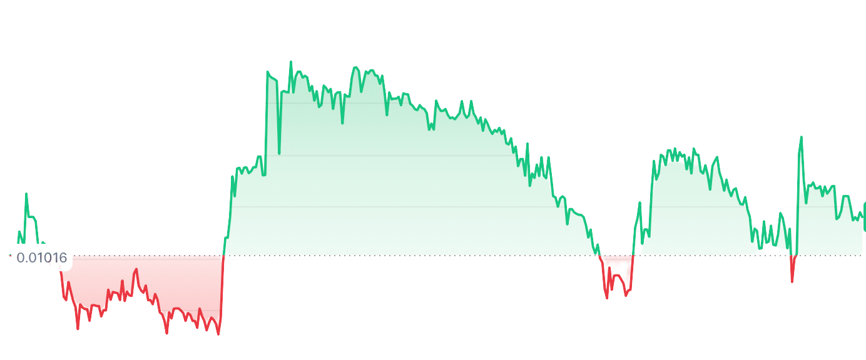
OR. . .
HOW TO OBTAIN CSR25 PLASTIC CREDITS 2
Directly on the public market
AT THE MARKET PRICE
Top 20 world exchange

Slide 25




YOU CAN BE PART OF THE SOLUTION
You can be a pioneer in this
REVOLUTIONARY BUSINESS

Slide 26

SIGN UP ON THE AMPLIVO PLATFORM
Request the link from the person who invited you.
AMPLIVO (Amplify Voice) is the crowdfunding arm of the CORSAIR organisation

Slide 27
JOIN THE
MISSION!
Help clean our planet from plastic
Be part of this world-leading company
Amplivo Associates are active in dozens of countries worldwide
An ethical and exclusive business, unique in the world.
For more information Contact me direct
ben@bencoker.net
Notes:
More about all this and how it works next time

