Slide 1



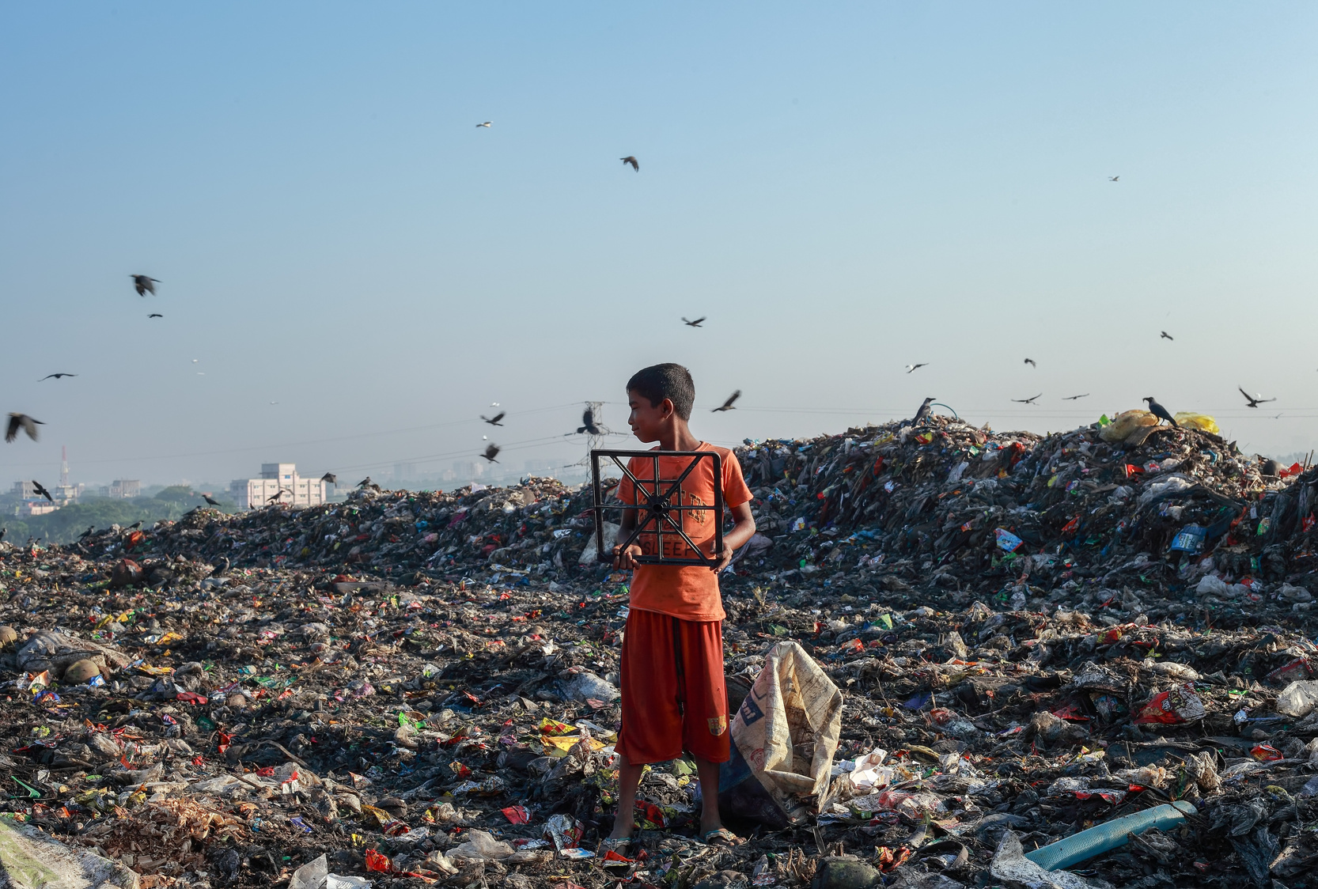
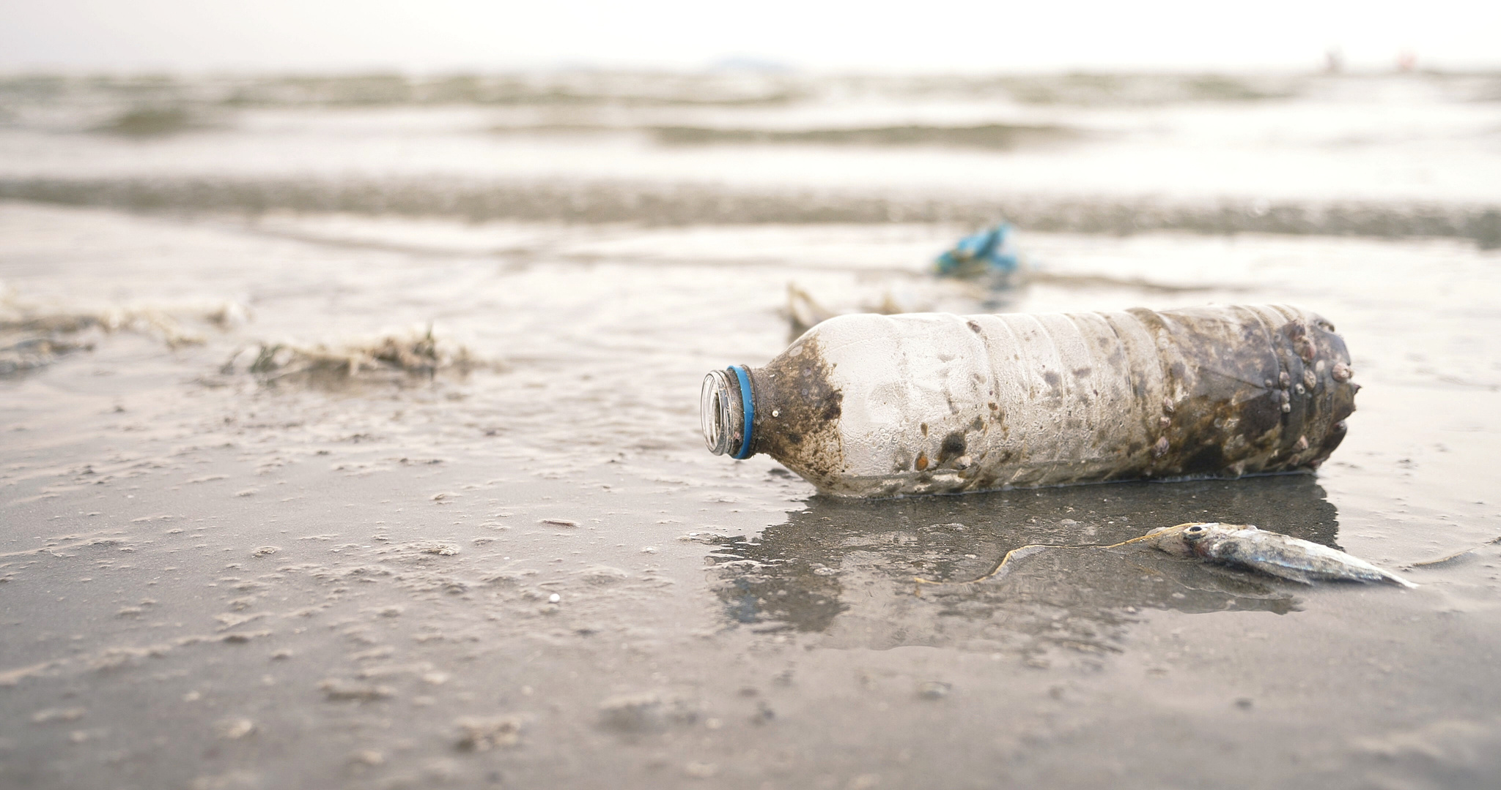
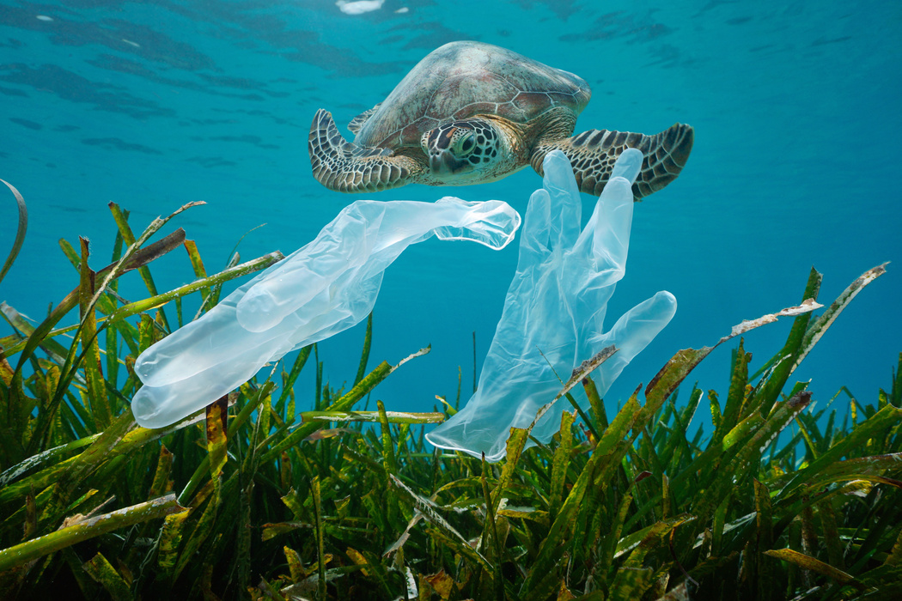
.
WELCOME

Slide 2




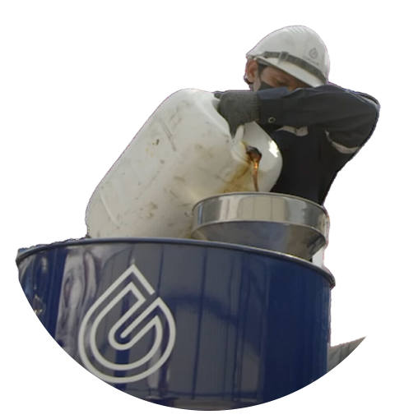
What we will see
In this presentation – or next time
PROBLEM
SOLUTION
VERIFICATION
OPERATION
PLASTIC POLLUTION
CORSAIR GROUP
INTERNATIONAL
CSR PLASTIC CREDIT
CORSAIR/AMPLIVO

Slide 3





SPREADING THE WORD
Help people and companies become PLASTIC NEUTRAL
It’s not a charity – it’s a commercial operation
AMPLIVO ASSOCIATES are the crowdfunding marketing arm of CORSAIR
Helping as many individuals and companies as we can to become PLASTIC NEUTRAL
For this (as in any marketing operation) we get paid.

Slide 4
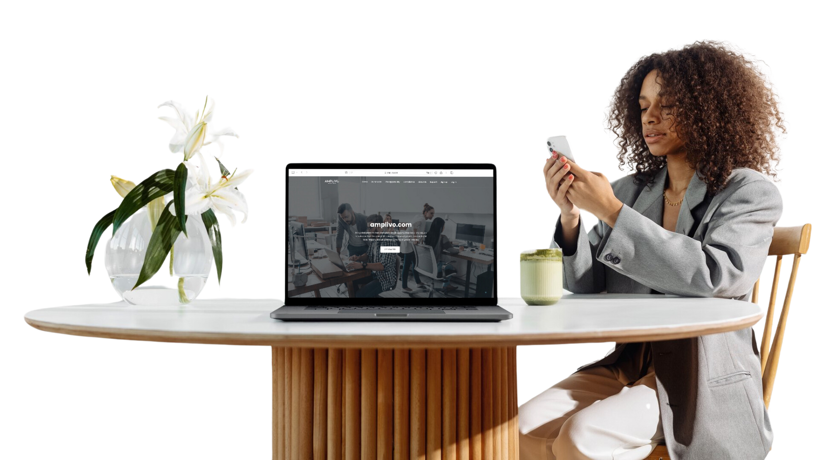
SIGN UP ON THE AMPLIVO PLATFORM
To purchase Plastic Neutrality Packages (PNP) as an individual and to be authorized to introduce others.
AMPLIVO (Amplify the Voice) is the crowdfunding arm of the CORSAIR organisation
FOLLOW THE LINK you were given by the person who sent you this

Slide 5
How to buy CSR plastic credits
the proof of your plastic neutrality
If you are a COMPANY
If you are a UK VAT registered Company, you can buy plastic credits direct at csrnow.com by simply transferring funds in Euros to the CSR Services Europe bank account.
Please note – this only applies with VAT registered companies at the present time
If you are an INDIVIDUAL or non-VAT registered Company
While purchase prices are in Euros, the funds to purchase PNPs (Plastic Neutrality Packages) must currently be made in USDT – a Crypto ‘stablecoin’ which matches the price of the US Dollar. This avoids excessive foreign exchange costs. Now we’ll show you how.
Wherever you are in the world all prices are stated in EUROS

Slide 6
The 5 STEPS to Plastic Neutrality
The FIRST STEP is to register on the Amplivo website using the link provided to you
STEP 2 – DECIDE ON WHAT YOU WANT - Go to the Shop, then Products and decide what Package you wish to purchase at this time. Currently we can only make one-off purchases. Plastic Neutrality Packages range from 10 to 100,000 euros. Go to ‘Shop’, then ‘Products’ and click ‘Add to Cart on the one you want, Click Add to cart again and check by going to the cart symbol in the top right menu bar. You’ll complete the purchase later.
STEP 3 – DEPOSIT FUNDS IN YOUR AMPLIVO WALLET - To do this you’ll need to have a digital currency wallet – we suggest one called METAMASK and we’ll show you next how to set that up and transfer funds to it and then transfer them to Amplivo. Transfer funds for what you’ve decided to buy plus about 10% to cope with currency fluctuations and transfer fees (which are usually les than $5) Watch the video for further guidance – OR – get the person who invited you to do it for you.
STEP 4 – PURCHASE A VOUCHER - For the product you wish to purchase
STEP 5 – EXCHANGE THE VOUCHER FOR YOR PNP
Notes:
Yes, we know it’s complicated but there are reasons behind it and the Company are working to improve the ‘experience’, but these things ‘take time’

Slide 7
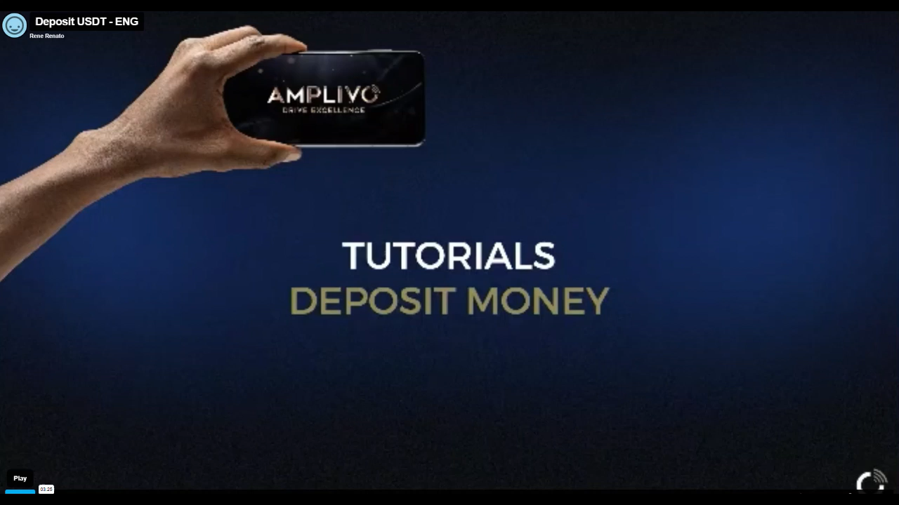

Slide 8
FUNDING YOUR AMPLIVO WALLET
DEPOSIT FUNDS IN YOUR AMPLIVO WALLET – Once you’ve set up your digital currency wallet and funded it with an appropriate amount of USDT you’re good to go. Follow the instructions you’ll find by selecting on the dashboard ‘Wallets’, then ‘My Wallet’, then ‘Deposit’.
You’ll be taken through the Amplivo Academy to a page which asks ‘Select Your Deposit Type’ (sometimes this goes by a rather circuitous route so it’s a good idea to be online with the person who introduced you to get help)
It is recommended you use USDT. If you choose EUR you will either have to sign up with a service called Mountain Wolf or the Kasikorn Bank in Thailand (min deposit 500 Euros) and there will be further delays and exchange fees if you want to fund with GBP.
Select the Blockchain to use which should be ERC20 and the USDT amount. (1 EUR is approx. $1.17 and £0.86) You should add at least 10% extra to the EUR amount to cover transfer fees and currency fluctuations.
Copy the address which starts 0xc…… and go over to your Metamask wallet to start the transaction
Alternatively – you can get the person who invited you to do this for you
Notes:
Sadly, at the present time there is no easy way to do this like the simple process you can follow as a VAT Registered Company – At the moment – “It’s complicated”
BUT IT IS WORTH IT!

Slide 9

How to use Metamask
We recommend you search ChatGPT, Claude, or another AI tool for the full details and also search YouTube for video explanations on how to set it up (You can download a pdf on this from https://amplivo.uk)
OR
Get the person who introduced you to Amplivo to help
Funding Metamask – there are various ways you can fund Metamask with USDT. The simplest is to select ‘Buy’ and purchase USDT by ‘Faster Payments’ from your bank. It will take you through a purchase agent , usually the one giving you the best deal at the time. Follow the instructions and your funds should arrive in a few minutes (maybe longer)
You’ll also need to purchase a small amount of ETH tokens to pay the ‘gas fees’ (the cost of using the network)
Transferring to Amplivo – Next go to ‘Send’ on the Metamask dashboard. Copy the ‘Send from’ address (click on the down arrow) to somewhere you can find it again. Enter the ‘Send’ address you get when you go into the Amplivo deposit process – (starting with 0xc). Select the Asset you wish to send (USDT) and the amount.
Click ‘Send’ and the transaction will take place.
Now you’ll need to enter the ‘From address’ and the Transaction Hash you’ll receive on the Amplivo deposit screen and click ‘Next’ to complete the process

Slide 10
GET YOUR CSR PACKAGE
STEP 1 – SET UP GOOGLE AUTHENTICATOR if you’ve not done so already as you’ll need the six-digit code to complete the purchase. There are prompts do this when you log in but if you’re not sure what it’s all about ask the person who introduced you.
STEP 2 – GET YOUR VOUCHER Now you can see your EUR balance in your Cash Account you can go to your cart on the top right menu (It’s a very small symbol, easily missed but may have a red number by it). Click on ‘Purchase’, enter your Google code and then choose either
Purchase as a Gift Code – this defers the purchase until the voucher is redeemed but it gives you the facility to send the code to someone else with an Amplivo account
or
Purchase and Redeem Now – this immediately exchanges the gift code to the PNP you have ordered on your account
If someone has sent you a gift code (your introducer or someone else) all you need to do is got to ‘Shop’, select ‘Redeem Amplivo Gift Code’, enter the code and you’ll receive your CSR package
Notes:
Sorry, but at the present time it’s STILLL ‘Complicated’. We’ve been promised it will all change for the better when the new system is ready in January – but don’t hold your breath!
SECRET HINT If you’re introducing someone to Amplivo who doesn’t want to go through all this hassle for themselves, they can send you the money and you can process the purchase for them through your Metamask account and so on and send them the Gift Card to get started – so long as they don’t expect it to happen immediately!

Slide 11
WHERE ARE YOUR PLASTIC CREDITS?
It’s a 2-step process to locate your PNP and CSR’s. first
On Your Amplivo Dashboard:
Go to ‘Shop’, then ‘My Purchases’ – you’ll see the receipt for your PNP
To see your CSR
Go to https://csrnow.com and log in using your Amplivo login details – click on ‘CSR Central’ then ‘My CSR’ where it shows your CSR account and when the tokens will be delivered.
Delivery Cycle
Week 1 – 5% of your tokens
Week 40 – a further 45%
Week 80 - the remaining 50%
This reflects the processing time from collecting the waste and delivering the processed pyrolysis oil

Slide 12



We are an Amplivo
Independent Associate
WE OFFER A PLASTIC WASTE REMOVAL SERVICE
(NOT A FINANCIAL PRODUCT).
THE CSR PLASTIC CREDIT IS A DIGITAL RECEIPT
WHICH CORRESPONDS TO A SPECIFIC
QUANTITY OF PLASTIC RECYCLED FROM
THE ENVIRONMENT.
IT IS NOT AN ‘INVESTMENT PRODUCT’
NO FINANCIAL LICENCE IS REQUIRED
FOR ITS SALE.

Slide 13
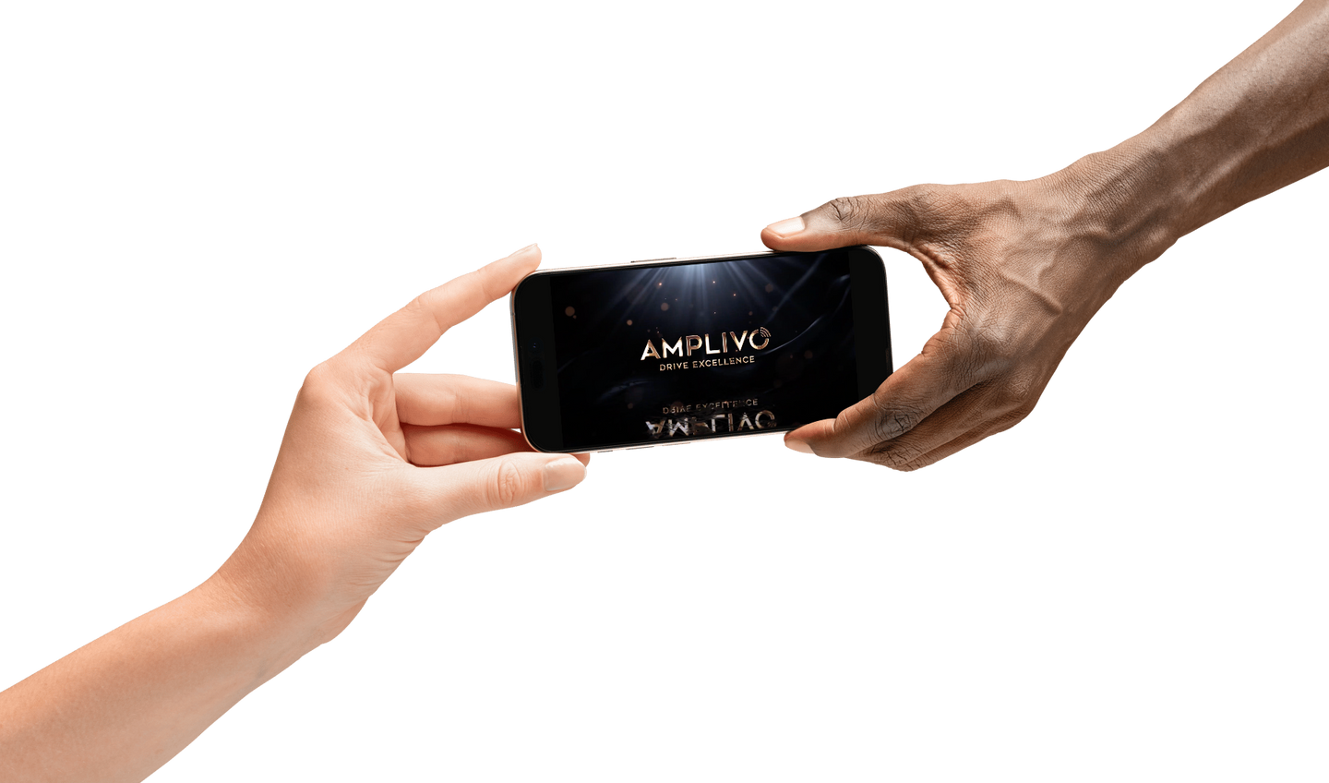

START NOW
Now you can promote our “plastic waste removal service” (PNP) packages.
The Amplivo network is active worldwide with members operating as Independent Businesses
The Following Presentation describes the BUSINESS PLAN
Explaining how you get rewarded on your personal promotional activity and that of those you introduce, who then become your NETWORK
Business Amplivo

Slide 14
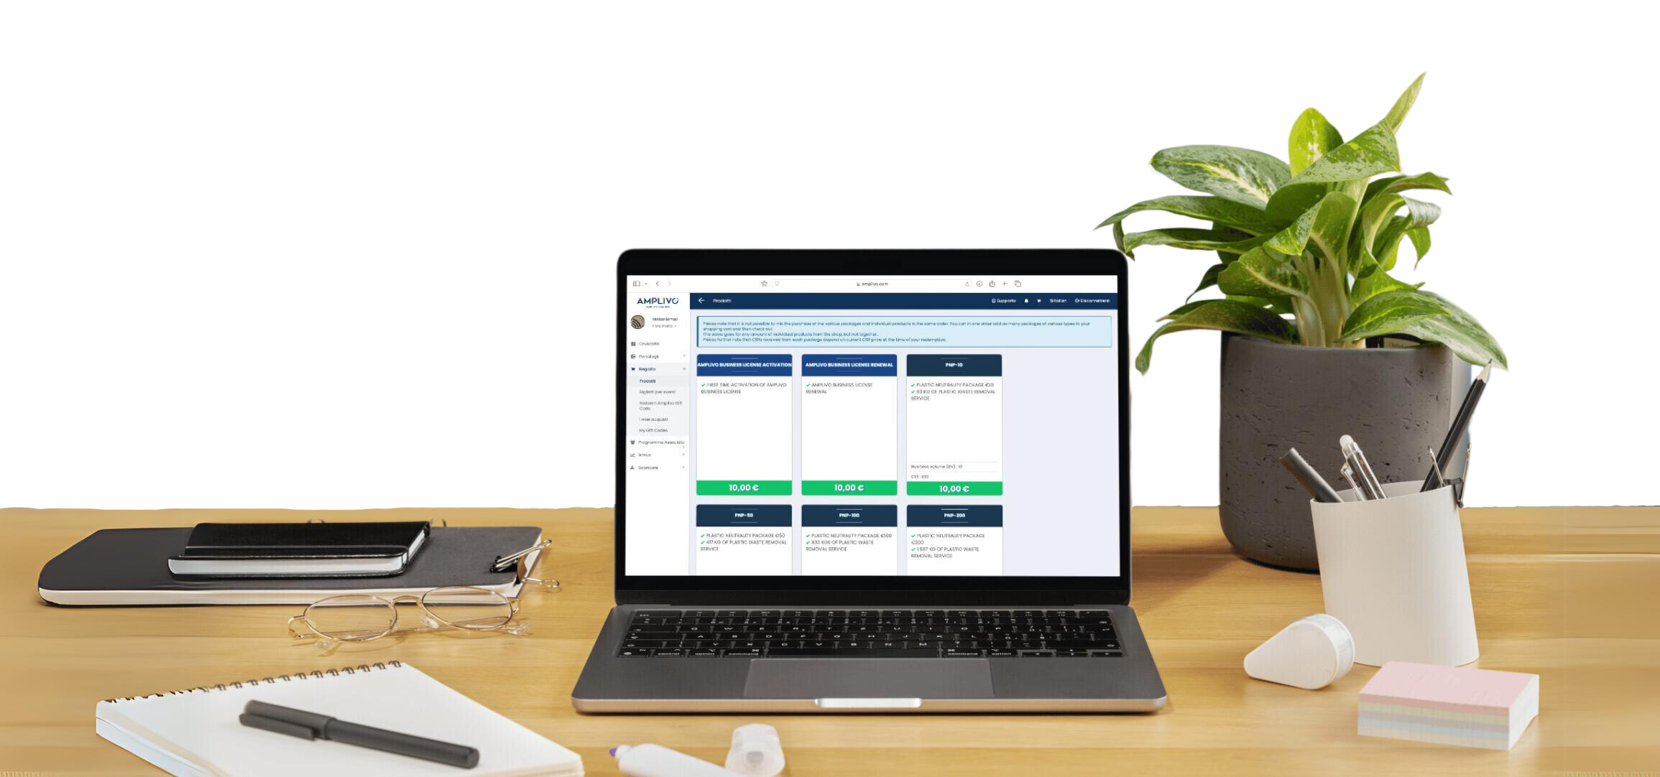
ACTIVATE your BUSINESS LICENCE
Become an Associate and earn commissions. (Activation only 10 Euro annually)
Go to the Shop, select Products and Select ‘First Time Business License Activation’
Use the funds in your Cash Account to purchase in the same way as your PNP
Congratulations! You are now an AMPLIVO ASSOCIATE

Slide 15
What to Send to Your Contacts
IT DEPENDS
What sort of person are they? Do they want a lot of detail? Do they want ‘all the facts’? Or are they a ‘Bottom Line-Big Picture’ person?
If you’re not sure what to do, Your Introducer will Help and Guide you as to what to send and how to do it
Then you can go to https://amplivo.uk from where you can download videos and other information to send, presentations and other material to help.
What to do when they say ‘Yes, I’m interested’
SEND THEM YOUR LINK
Your Independent Associate Sponsor Link will appear at the top of your Dashboard page. It looks like this – with your name at the end https://amplivo.com/sponsor/BenCoker
This will take them to the Amplivo Registration screen where they will create their personal Account
Business Amplivo

Slide 16
How We Get Paid
As in every business where something is changing hands for money the person responsible for the transaction receives a fee in the form of a commision on the value of the exchange.
The commission we receive is based on three things
The value of each individual transaction
The accumulated volume of those transactions
The number of people in our personal ‘network’
Definitions
BV = Business Volume in Euros, 1BV = €1
PGV = Personal Group Volume = amount of BV from the people we have personally introduced
The Network
Level 1 – people you have personally introduced
Level 2 - people your Level 1 members have introduced
Level 3 - people your Level 2 members have introduced
And so on

Slide 17
The starting point
This is called the ‘Uni-Level Bonus’ and it covers the first 5 levels in your network
Network Commissions you receive at the end of the week (Friday)
Level 1 = 12%
Level 2 and 3 = 8%
Level 4 and 5 = 5% (To receive these bonuses you must have also introduced 3 partners in your network)
How the Bonus is Paid
70% is paid in Euros into your Amplivo Online Cash Account
30% is paid into your Bonus Account
The Cash Account is your ‘working account’ with a balance shown in Euros. When it reaches €150 funds can be withdrawn (in USDT)
The Bonus Account is for internal purchases – more about this later.
PUT SIMPLY – for each person you personally introduce you receive 12% of the transaction. A purchase of €1000 would give you €120 with €84 in your Cash Account
Notes:
Note: need to complete KYC before any withdrawals can be made

Slide 18
Growing your Business
Your initial focus should be on bringing people into Level 1 of your network. There is no limit.
They receive 10 CSR tokens for every Kilo of Plastic Waste recycled using the funds they have provided.
They can become personally ‘Plastic Neutral’ – even ‘Plastic Positve’ and the value of those CSRs may increase over time
AT THE SAME TIME . . .
Encourage the people in your growing network to start introducing others – to generate your second and third levels and so on. They become ‘Partners’ in your business.
AS YOUR BUSINESS GROWS . . .
A further two levels of Bonus become available based on your Personal Group Volume and accumulated Business Volume. These are called the ‘Matching Bonus’ and the ‘Infinity Star Bonus’. The details of these will be described when you approach qualification for them.
But first we need to explain . . .

Slide 19
THE STAR SYSTEM
The higher Bonuses depend on the ‘Star Level’ you have reached
To earn Star levels there are two requirements PSR (Personally Sponsored Requirement) the number of people you’ve introduced as customers or partners, and total accumulated BV in your team
1 Star = 2 PSR + 10,000 BV
2 Star = 2 PSR + 50,000 BV
3 Star = 3 PSR + 250,000 BV
4 Star = 5 PSR + 1,000,,000 BV
5 Star = 5 PSR + 2,000,000 BV
6 Star = 10 PSR + 10,000,000 BV
7 Star = 10 PSR + 50,000,000 BV
Notes:
It takes a while to get to 6 or 7 star, but it can be done, and has been done

Slide 20
NOW LET’S GET STARTED!
Remember - if you’re not sure what to do, Your Introducer will Help and Guide you as to what to do and how to do it
Business Amplivo

